Slide 1
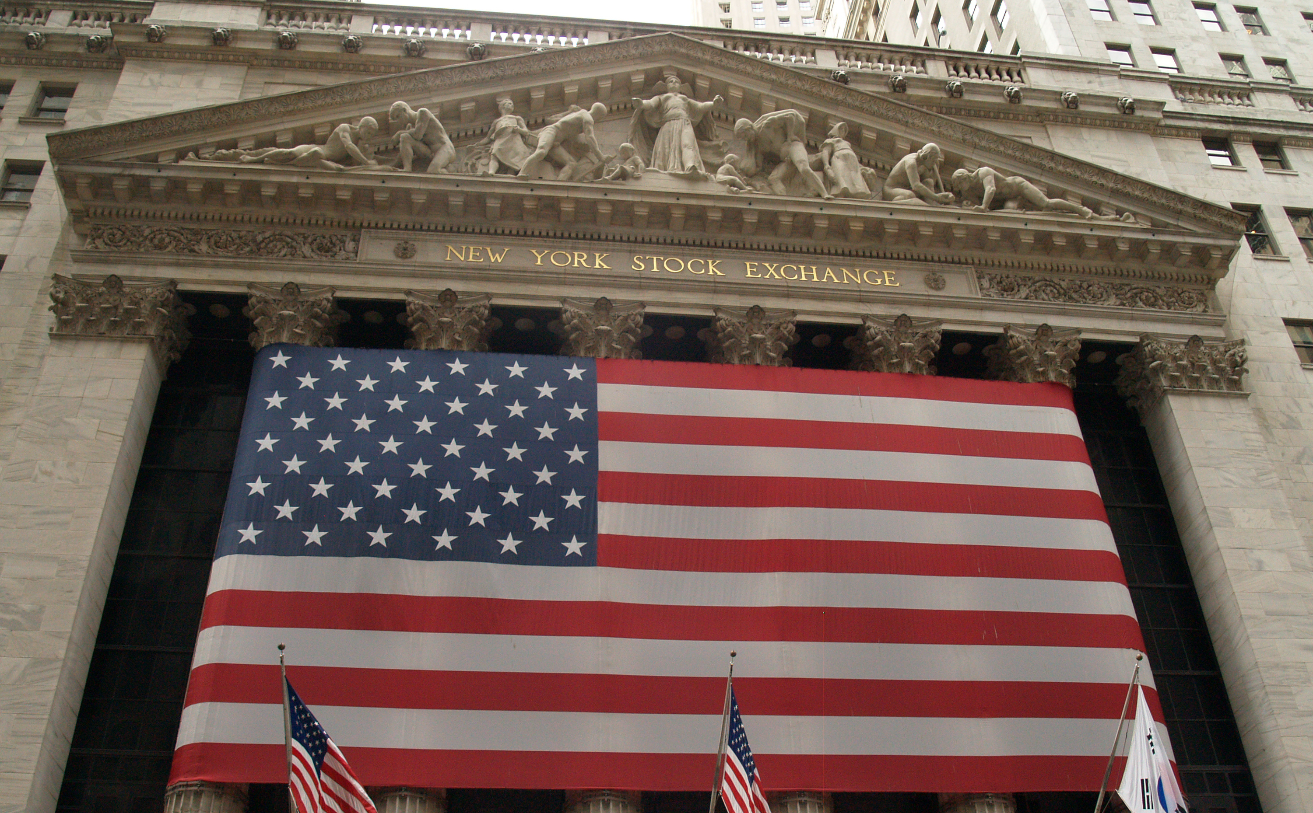
Timing the Stock Market with Members of Congress
NYC Data Science Academy – R Project
February 24th, 2023
Brian Ralston
Notes:
­­­­Thank you all for your time, and welcome to my presentation: ”Timing the market with Congress”
For my presentation, I chose to look at a dataset that outlines the stock trades of congress members over the past 9 years.

Slide 2

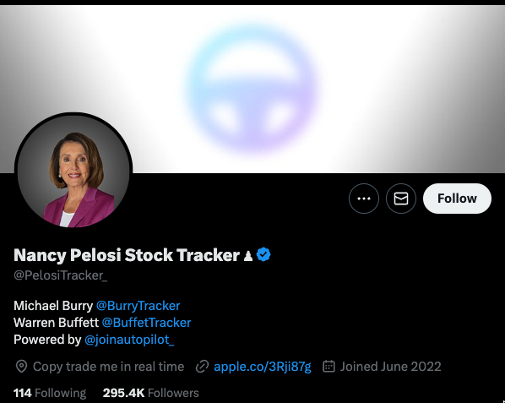
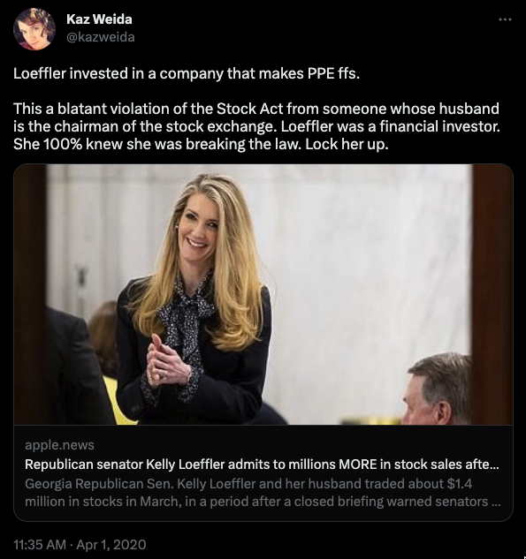
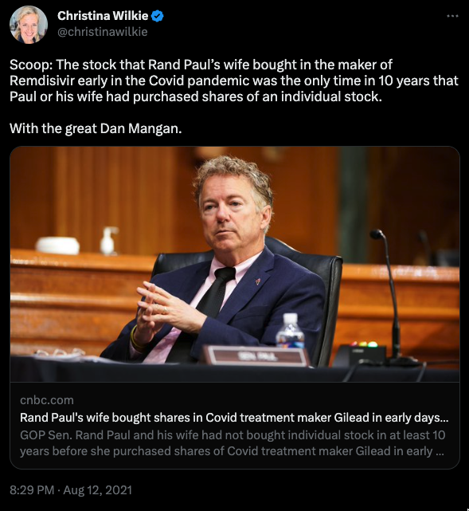
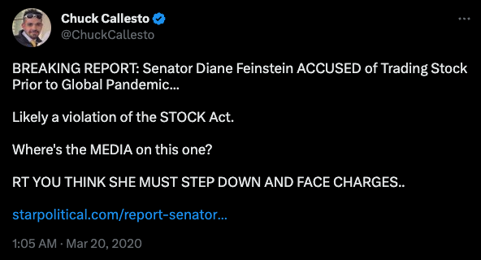
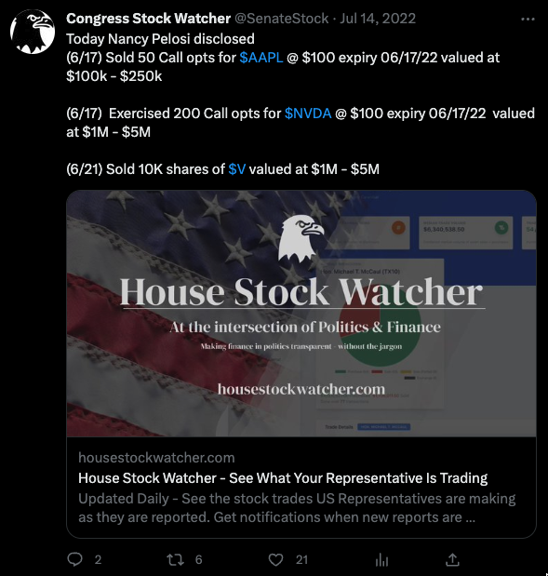
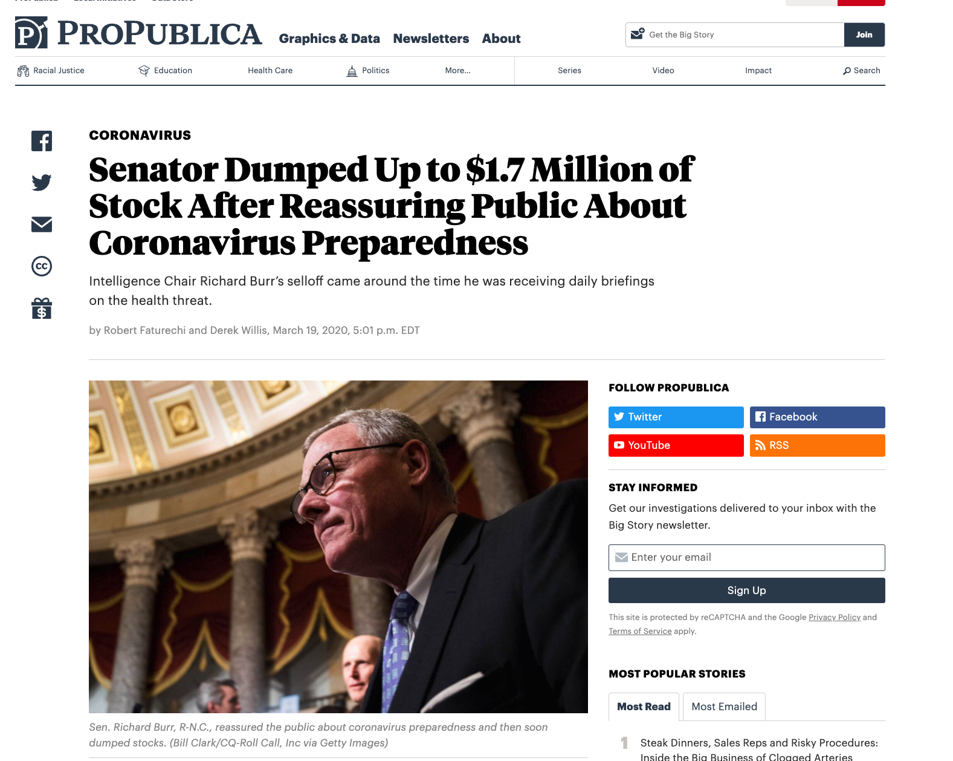
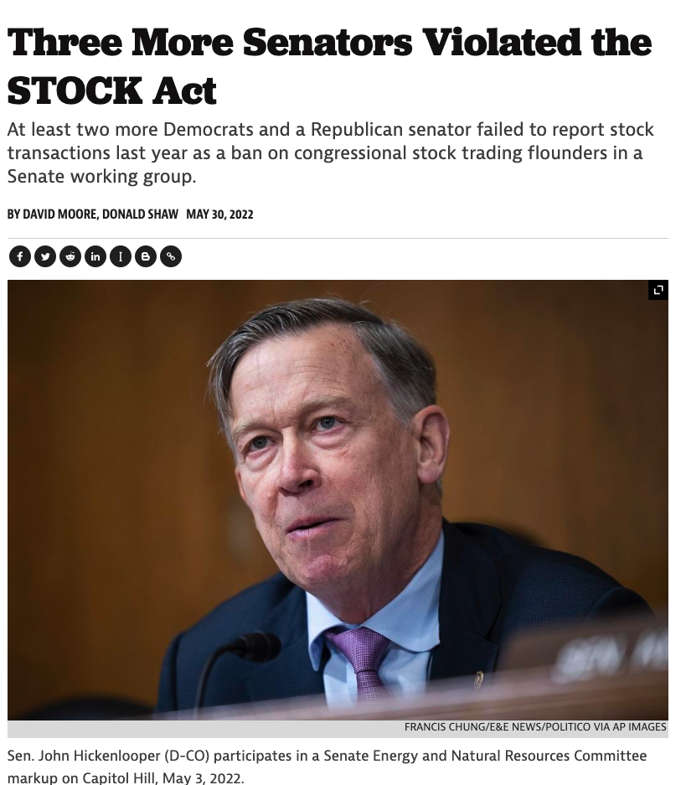
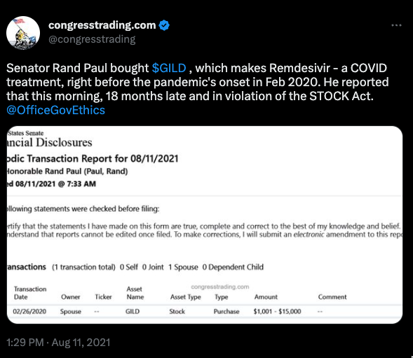
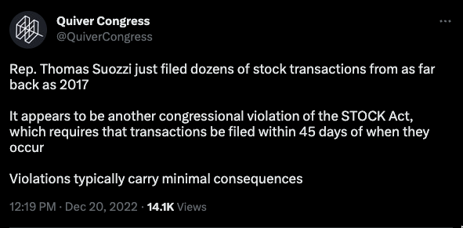
Notes:
Over the past few 3-4 years, there has been increased dialogue around insider trading in congress.
There is a huge conflict of interest of being in that position of power and and having insight to so many aspects of society. It erodes the trust of the public in these individuals and distracts from the whole reason of them being there; to serve the public.
I have following the news on this since march 2020 when many senators including Richard Burr, Kelly Loeffler, David Perdue, and the list goes on.
…
but it started to interest me once I realized that investors were actually using these reports to weigh Their decisions in what stocks to buy and sell.
Since this information was public, and the senators weren’t following the rules very well, and being pretty blatant about it as well,
CLICK
Investment advisors and social media influencers took full advantage.
Influencers online started touting these reports as cheat sheets for some quick money. Twitter accounts like Pelosi tracker started popping up (which currently has 250k follower) sending out alerts when Pelosi would file one of these reports.

Slide 3
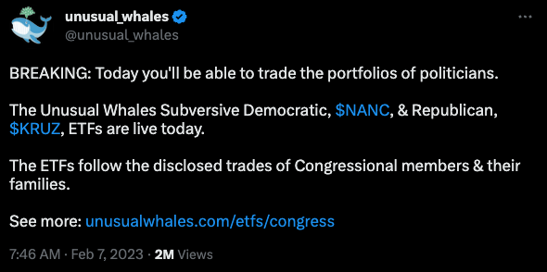
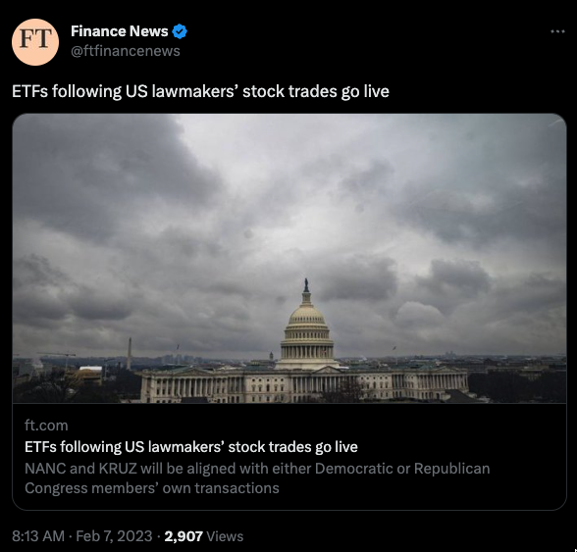
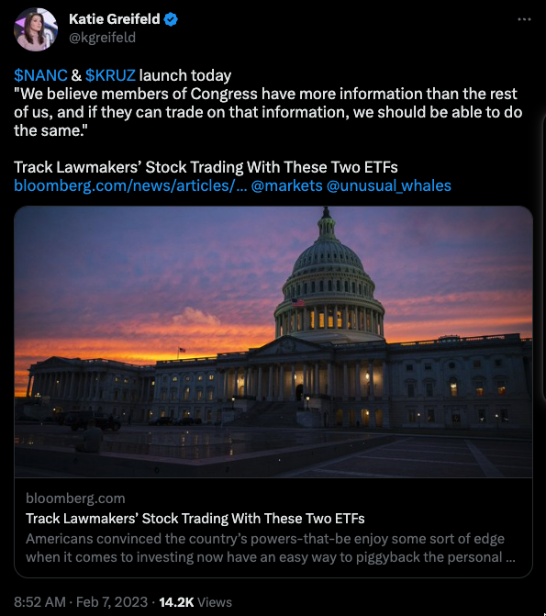
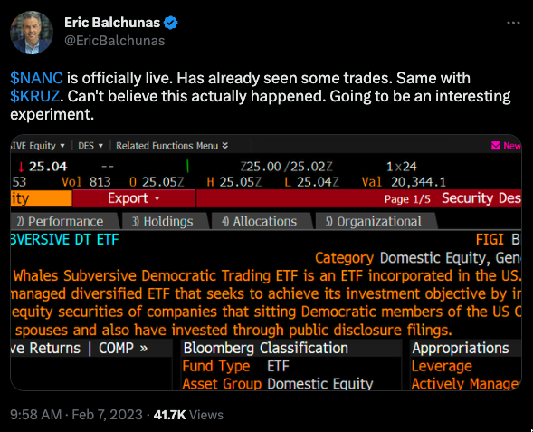
Notes:
This type of news gained so much traction, that two ETF’s just started trading on the market the other day on February 8th 2023
The ETFs NANC and KRUZ (Named after Nancy Pelosi and Ted Kruz) are a joint effort between investment firm, Subversive Capital, and equity data platform, Unusual Whales.
The ETFs buy and sell securities based on an analysis of the disclosures mentioned previously, and are separated into Democratic (NANC) and republican (KRUZ).
Both funds are actively managed and carry a hefty annual fee of 0.75%

Slide 4

Notes:
So…How did we even Get to this point?
…
People looking into this have spent a massive amount of time breaking down these reports through investigative journalism, massive online community efforts., etc.
Politicians are not in office to make money, they are in office to serve their constituents and communities.
The New York Times did a MASSIVE investigative report recent;y on 97 congress members, showing conflicts of interest and suspicions trades. (https://www.nytimes.com/interactive/2022/09/13/us/politics/congress-members-stock-trading-list.html)
They took a team of 100 analysts and spent thousands of hours breaking this all down.
I Knew this type of data set was interesting, but I don’t have that kind of time and resources like the NY Times.
So with this project, I am not going to figure out WHO is an insider trader, or even try to pass any judgement.
I will leave that to the Standards and ethics committee to prosecute all these individuals appropriately…of which, not a lot has been done…

Slide 5
Notes:
What really interested me about this topic, and was accessible for me to analyze as an individual, was the fact These reports need to be filed in a timely manner. Obiously not everyone follows that rule, but they are supposed to be filed within 45 days.
I can aggregate these reports, and look at which congress members are really good at trading stocks.
I mean, this is definitely a very unique opportunity.
Conceivably…
A civilian, could get relatively timely alerts about a person that has a proven track record of successful trades and some ethically questionable insider knowledge.
Again, this is really wild, however
A representative, might have more value to a civilian as a stock market “financial advisor”, than an actual government official.
Regardless, let’s dive in and see Who is the best at timing the market.

Slide 6
Notes:
First, I would like to investigate if the government as a whole. I want to look at large aggregates and see if congress members average out a good return, or if the even beat the S&P500,
Afterwards, I’ll dive in deeper to some individuals that made some particularly well timed trades and see which government officials I should follow for stock advise.

Slide 7

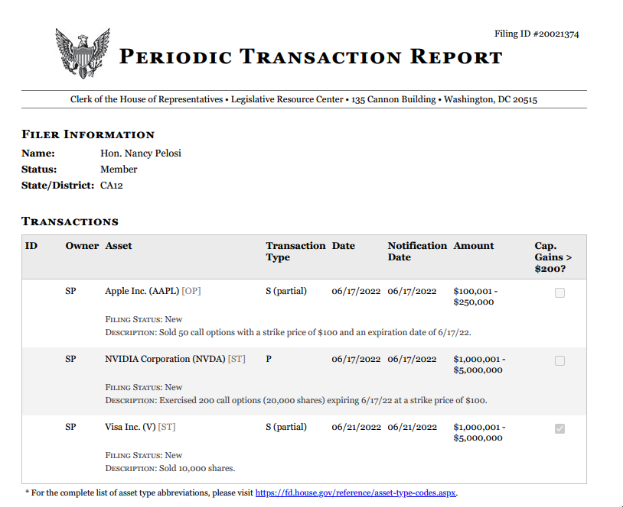
Notes:
So What are these reports that all of this is based on?
The reports are called Periodic Transaction Reports (PTRs) and are a type of disclosure required by the STOCK Act of 2012. The STOCK Act requires certain government officials and employees, including members of Congress and their staff, to publicly disclose their financial transactions within 45 days of the transaction. These reports are then made publicly available through the Clerk's website.
The purpose of PTRs is to increase transparency and reduce the potential for conflicts of interest in government. By requiring timely disclosure of financial transactions, the public can see if an elected official or government employee has made trades that could be influenced by their position or access to non-public information.
Just like many government programs, they make it publicly available, but not easy to access.
The clerk’s office doesn’t offer the information aggregated in a csv, or have an api. Instead, they publish individual .pdfs of each and every submission
Despite the challenges, there are a few online communities that have taken these forms and created a database of the information to for easier public review. For my project, I depended on the website https://housestockwatcher.com/api for their api which is maintained by Timothy Carambat
They have a community of people who review the .pdf’s daily and manually transcribe the data into this database.

Slide 8




Dataset Variables
Representative Name
Party/ Branch
State/District
Ticker Symbol and Sector
Disclosure Date
Transaction Date
Transaction Value Range (i.e. $1k-$15k)
Disclosure & Transaction Date
Buy or Sell (Gain >$200)
Ticker Price from Trans Date
Price 7/30/90/365 days later
S&P500 Price with same
Notes:
There are A LOT of these transactions on file; roughly 22k so far that I downloaded.
In all of those transactions a periodic Transaction Report is filed.
Here are the data points that I was able to collect from these reports:
READ EVERY BULLET ABOVE
Let’s be clear about what I CAN’T Gather from this information.
EXACT amount of stocks traded is NOT available to me. Neither the exact USD Value or the # of stocks traded.
And because of that I don’t have the ability to accurately recreate each representatives Stock Portfolio, as I do not know what they held before they started filing these reports, and as stated before, I don’t know the exact amounts they are trading.

Slide 9
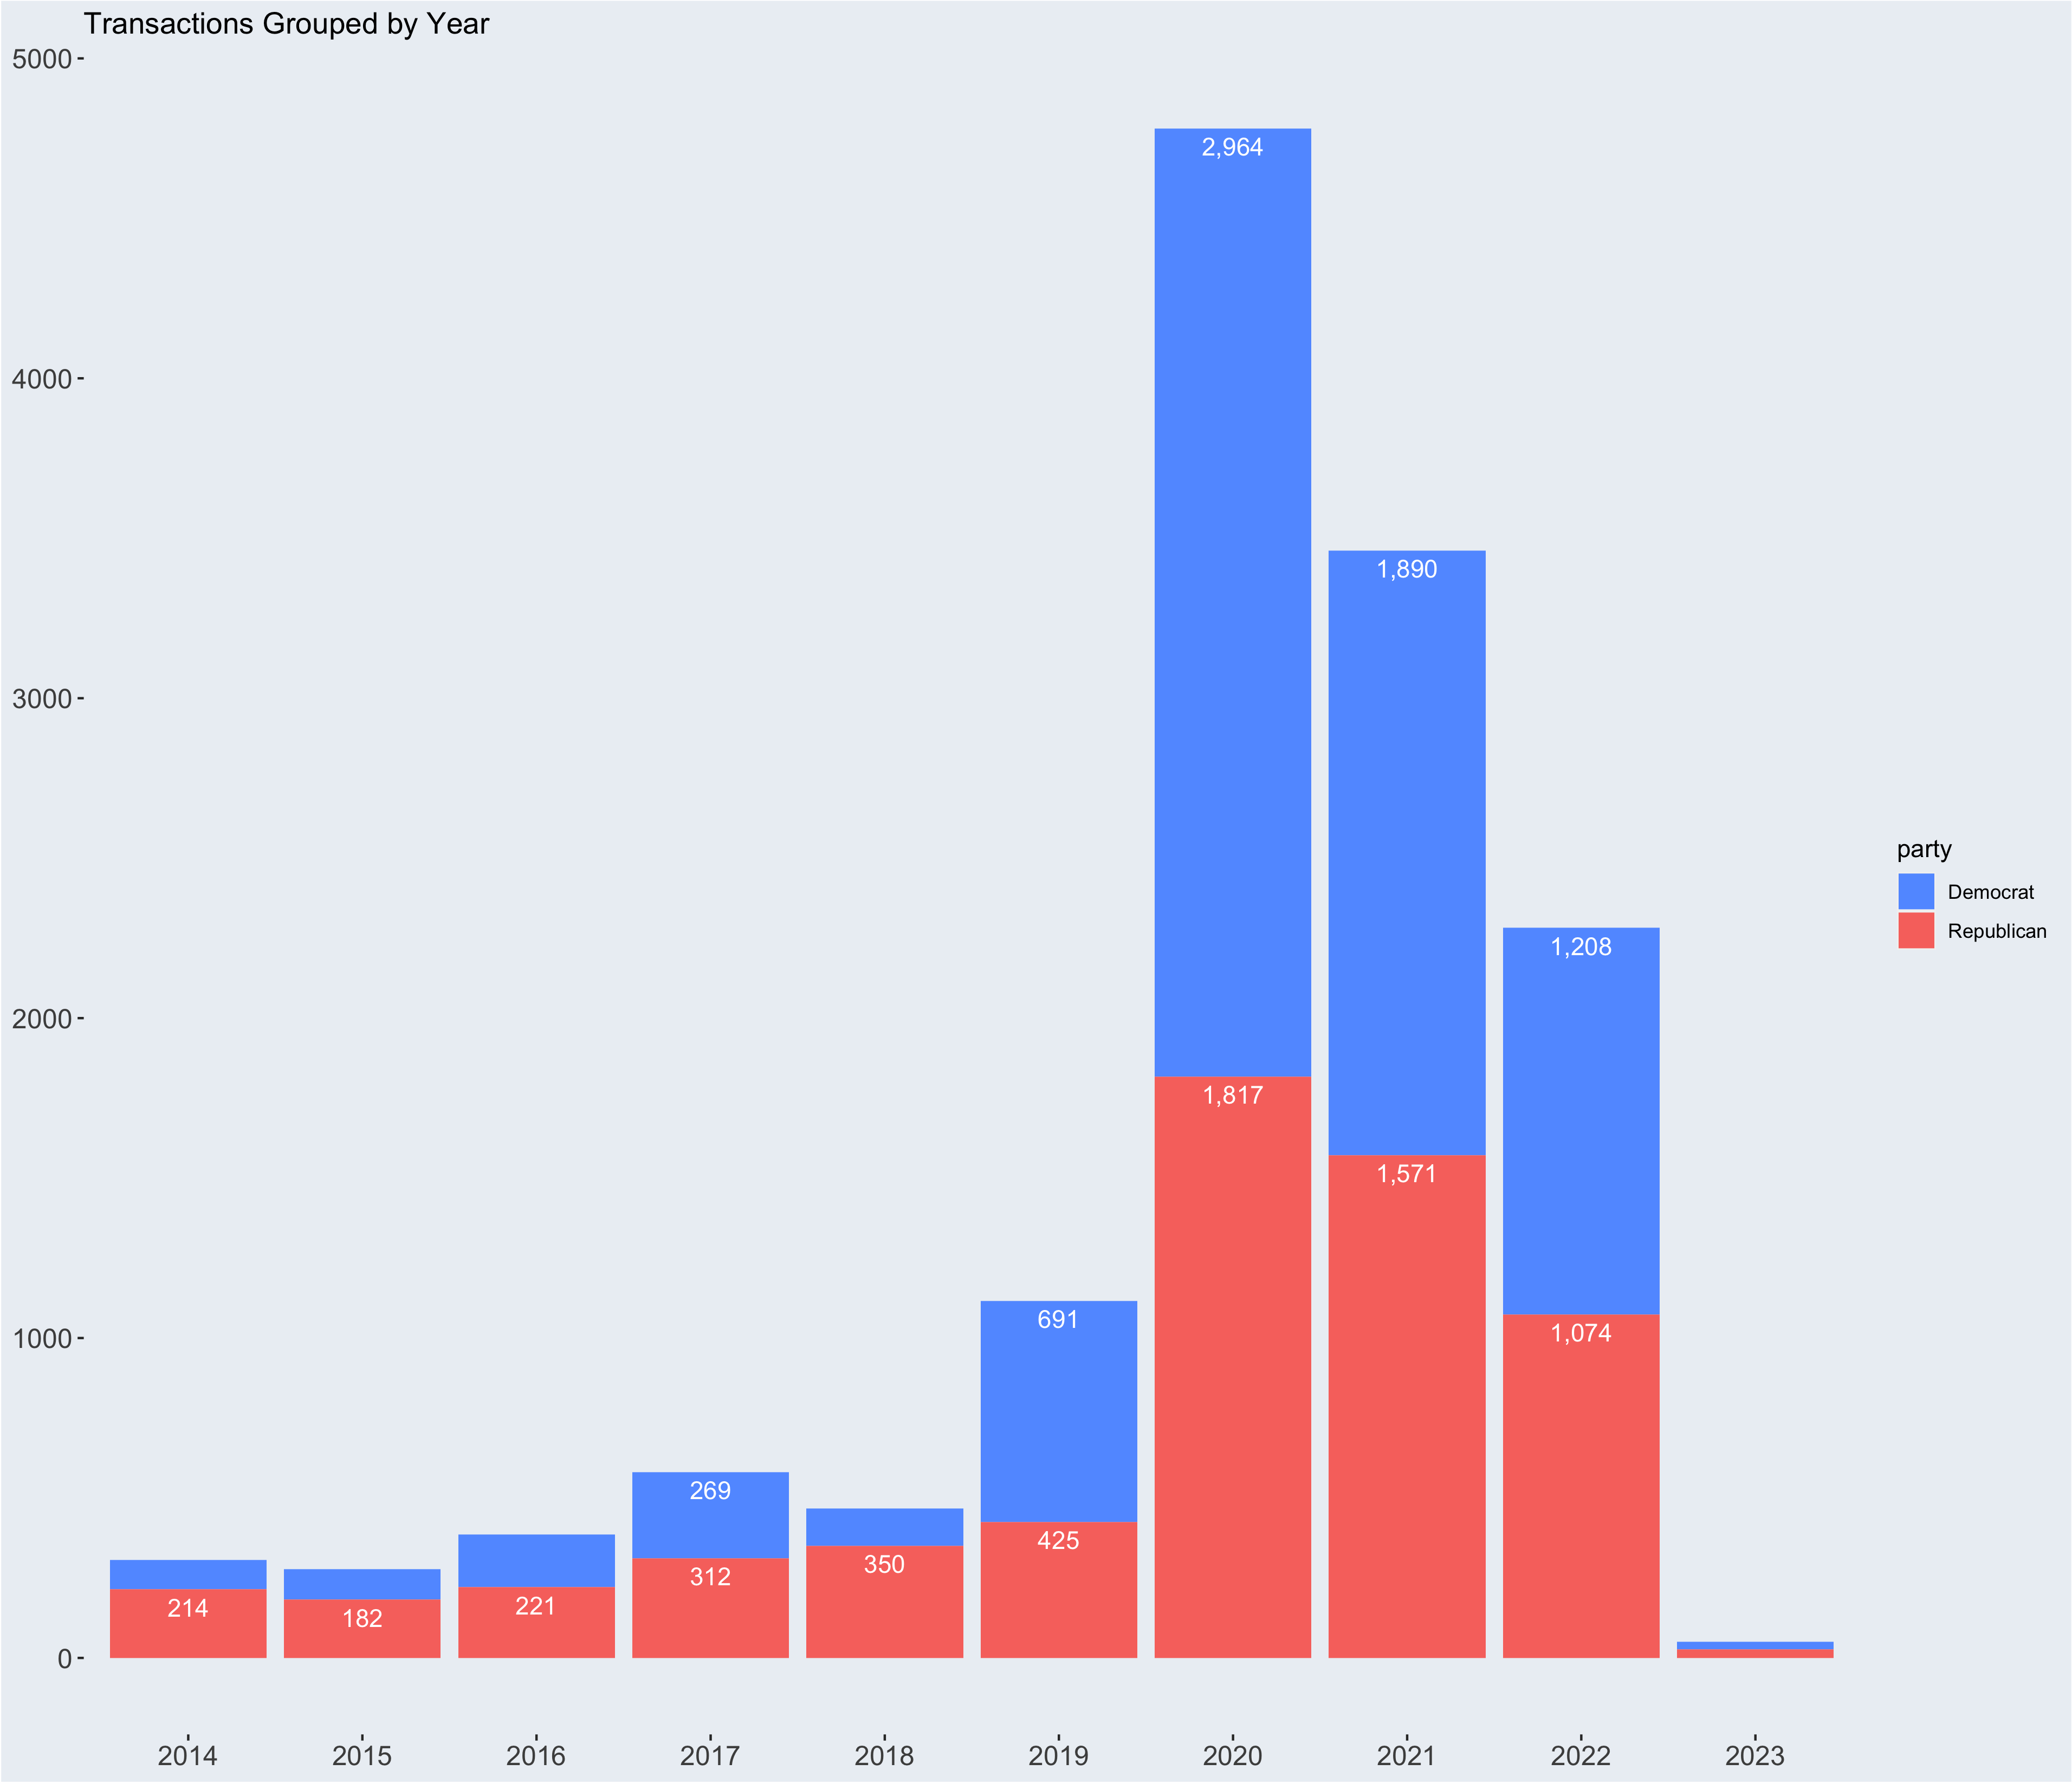
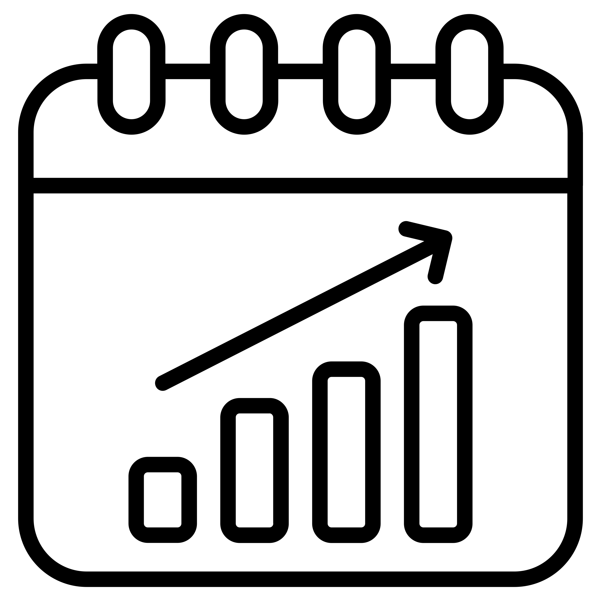

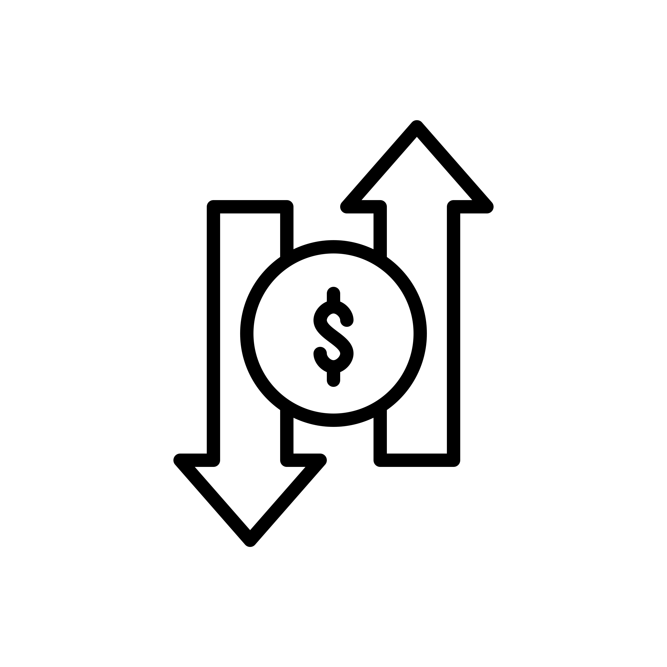

Data Summary
2014 – 2023
Avg: 12 Trades/day
Max/day: On 3/18/20 - 255 Trades
16,430 Trades
8,793 (D)
7,591 (R)
Trade Count
Range: 1 – 1,050
Avg: 82.6 Trades
Median: 17
$1k – $25M
Avg: ~$22k – $80k
Median: $1k – 15k
13% of Sell Trades
>$200 Gain
Notes:
After cleaning up the data I was left with around ~16k transactions that had valid tickers and complete data that I could match up with scraped stock prices from yahoo finance.
The observations took place from 2014-01-31 to 2023-02-06. There was an average of 12 trades per day and the maximum number of trades in a day was 255 on 3/18/2020
Of those ~16k transactions 8,793 trades were made by Democrat’s and 7,591 were made by republicans
Grouping the data by individuals, Representatives made as few as 1 trade and as many as 1,050 trades throughout this time period, with the avg congress member trading 82.6 times and a median of 17 trades which implies a distribution curve skewed to the left
The transactions themselves ranged from $1k (the minimum amount for reporting) all the way up to a $25M trade, which was made by Senator Susan Collins from Maine where she bought $25M worth of the company 3M on 2015-03-03
The Avg transaction range was from $22k-$80k and the median transaction as in the $1-15k range
Of all of the Sell Transactions that were reported, only 13% of them were sold for a gain.
TALK ABOUT THE graph

Slide 10
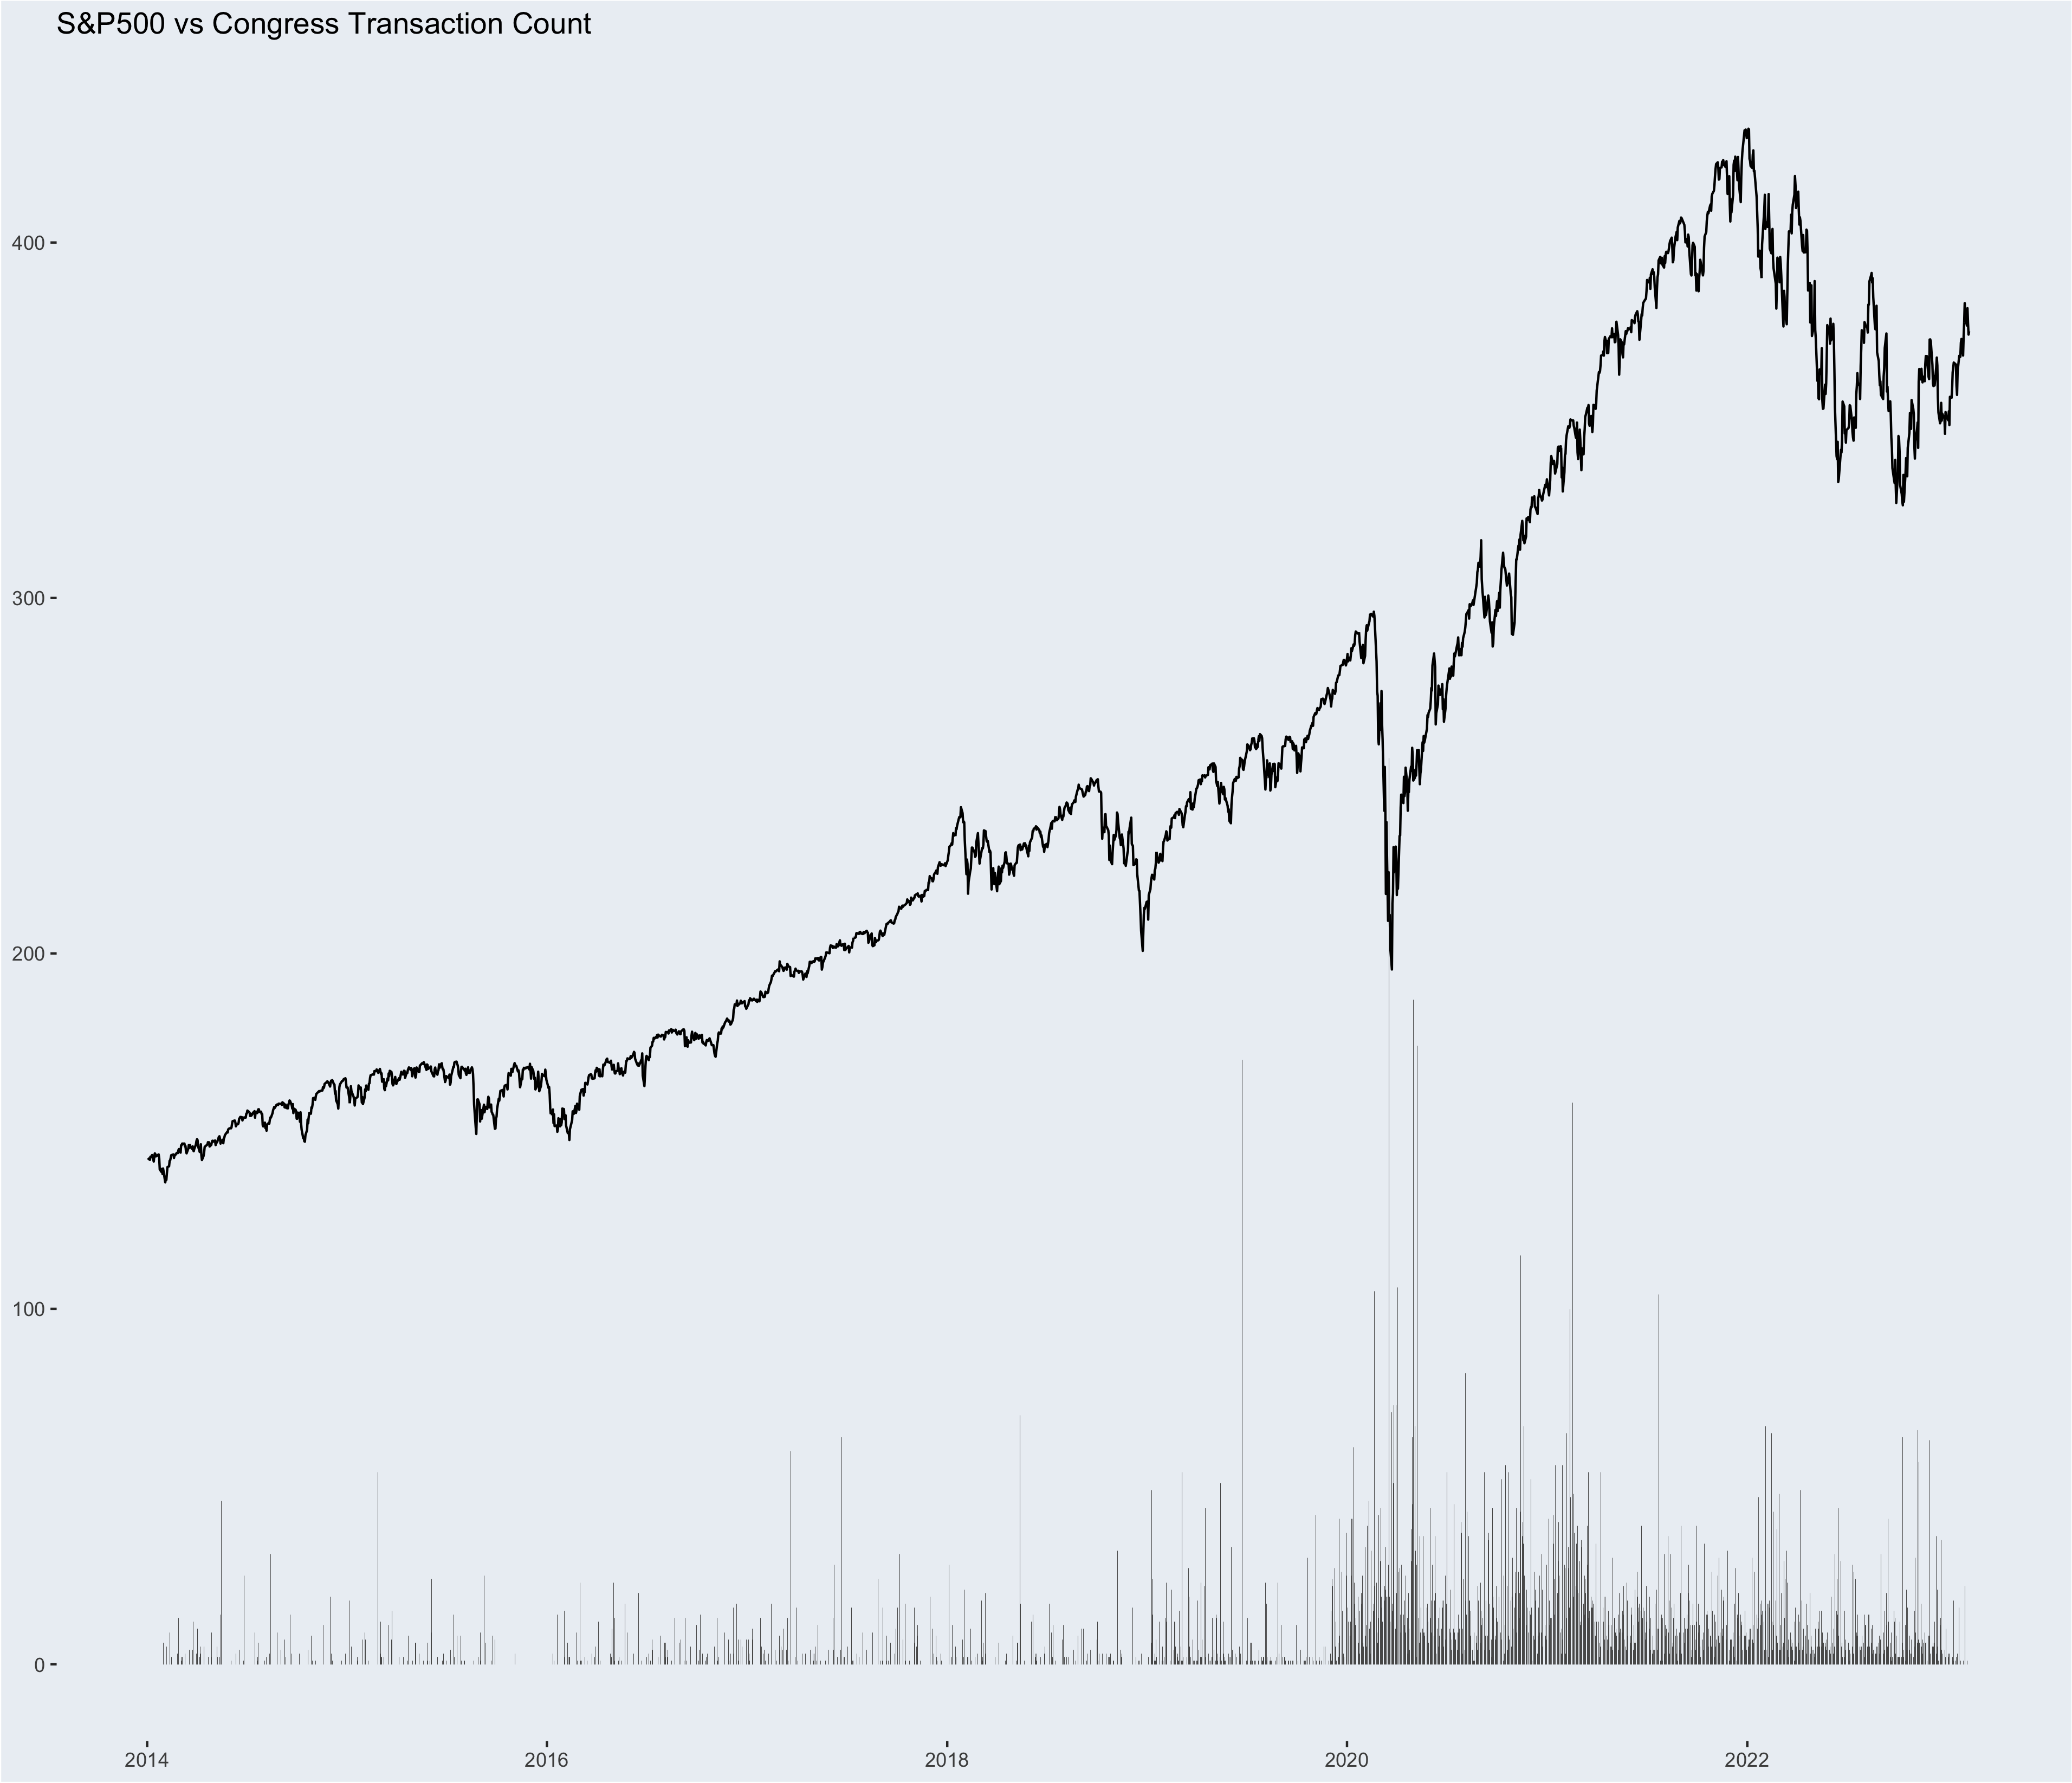
Notes:
Timing the Market
Here is an even MORE detailed version of the previous graph with the S&P500 overlayed.
You can clearly see a spike in Congress trade activity during the covid 19crash in Marh 2020, again however, everyone was buying and selling at that time.

Slide 11
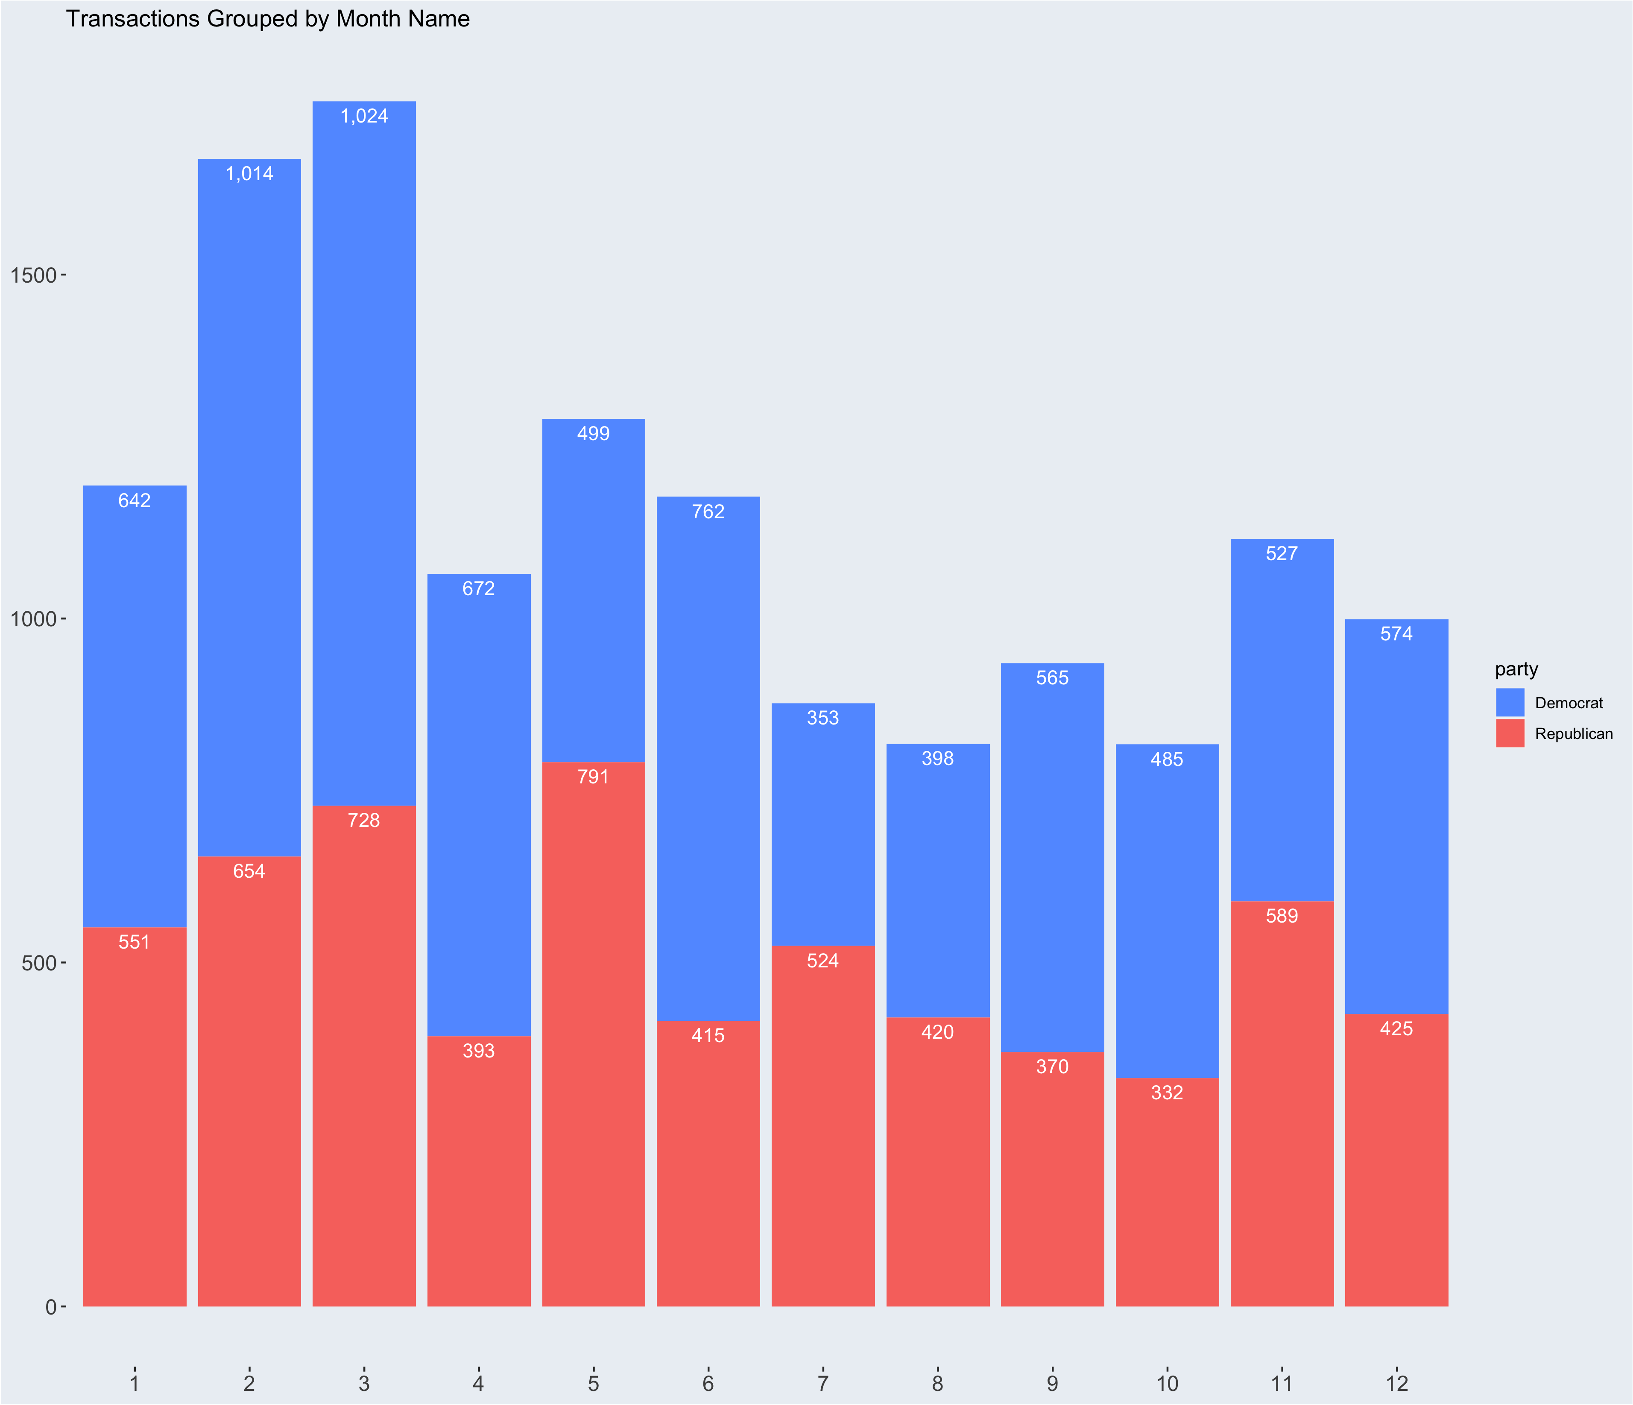
Notes:
This is a chart grouped by months, spanning over all years.
It seems as though the beginning of the year is a popular time for stock trading, again, that may just be skewed by the large increase of transactions of the march 2020 crash.

Slide 12
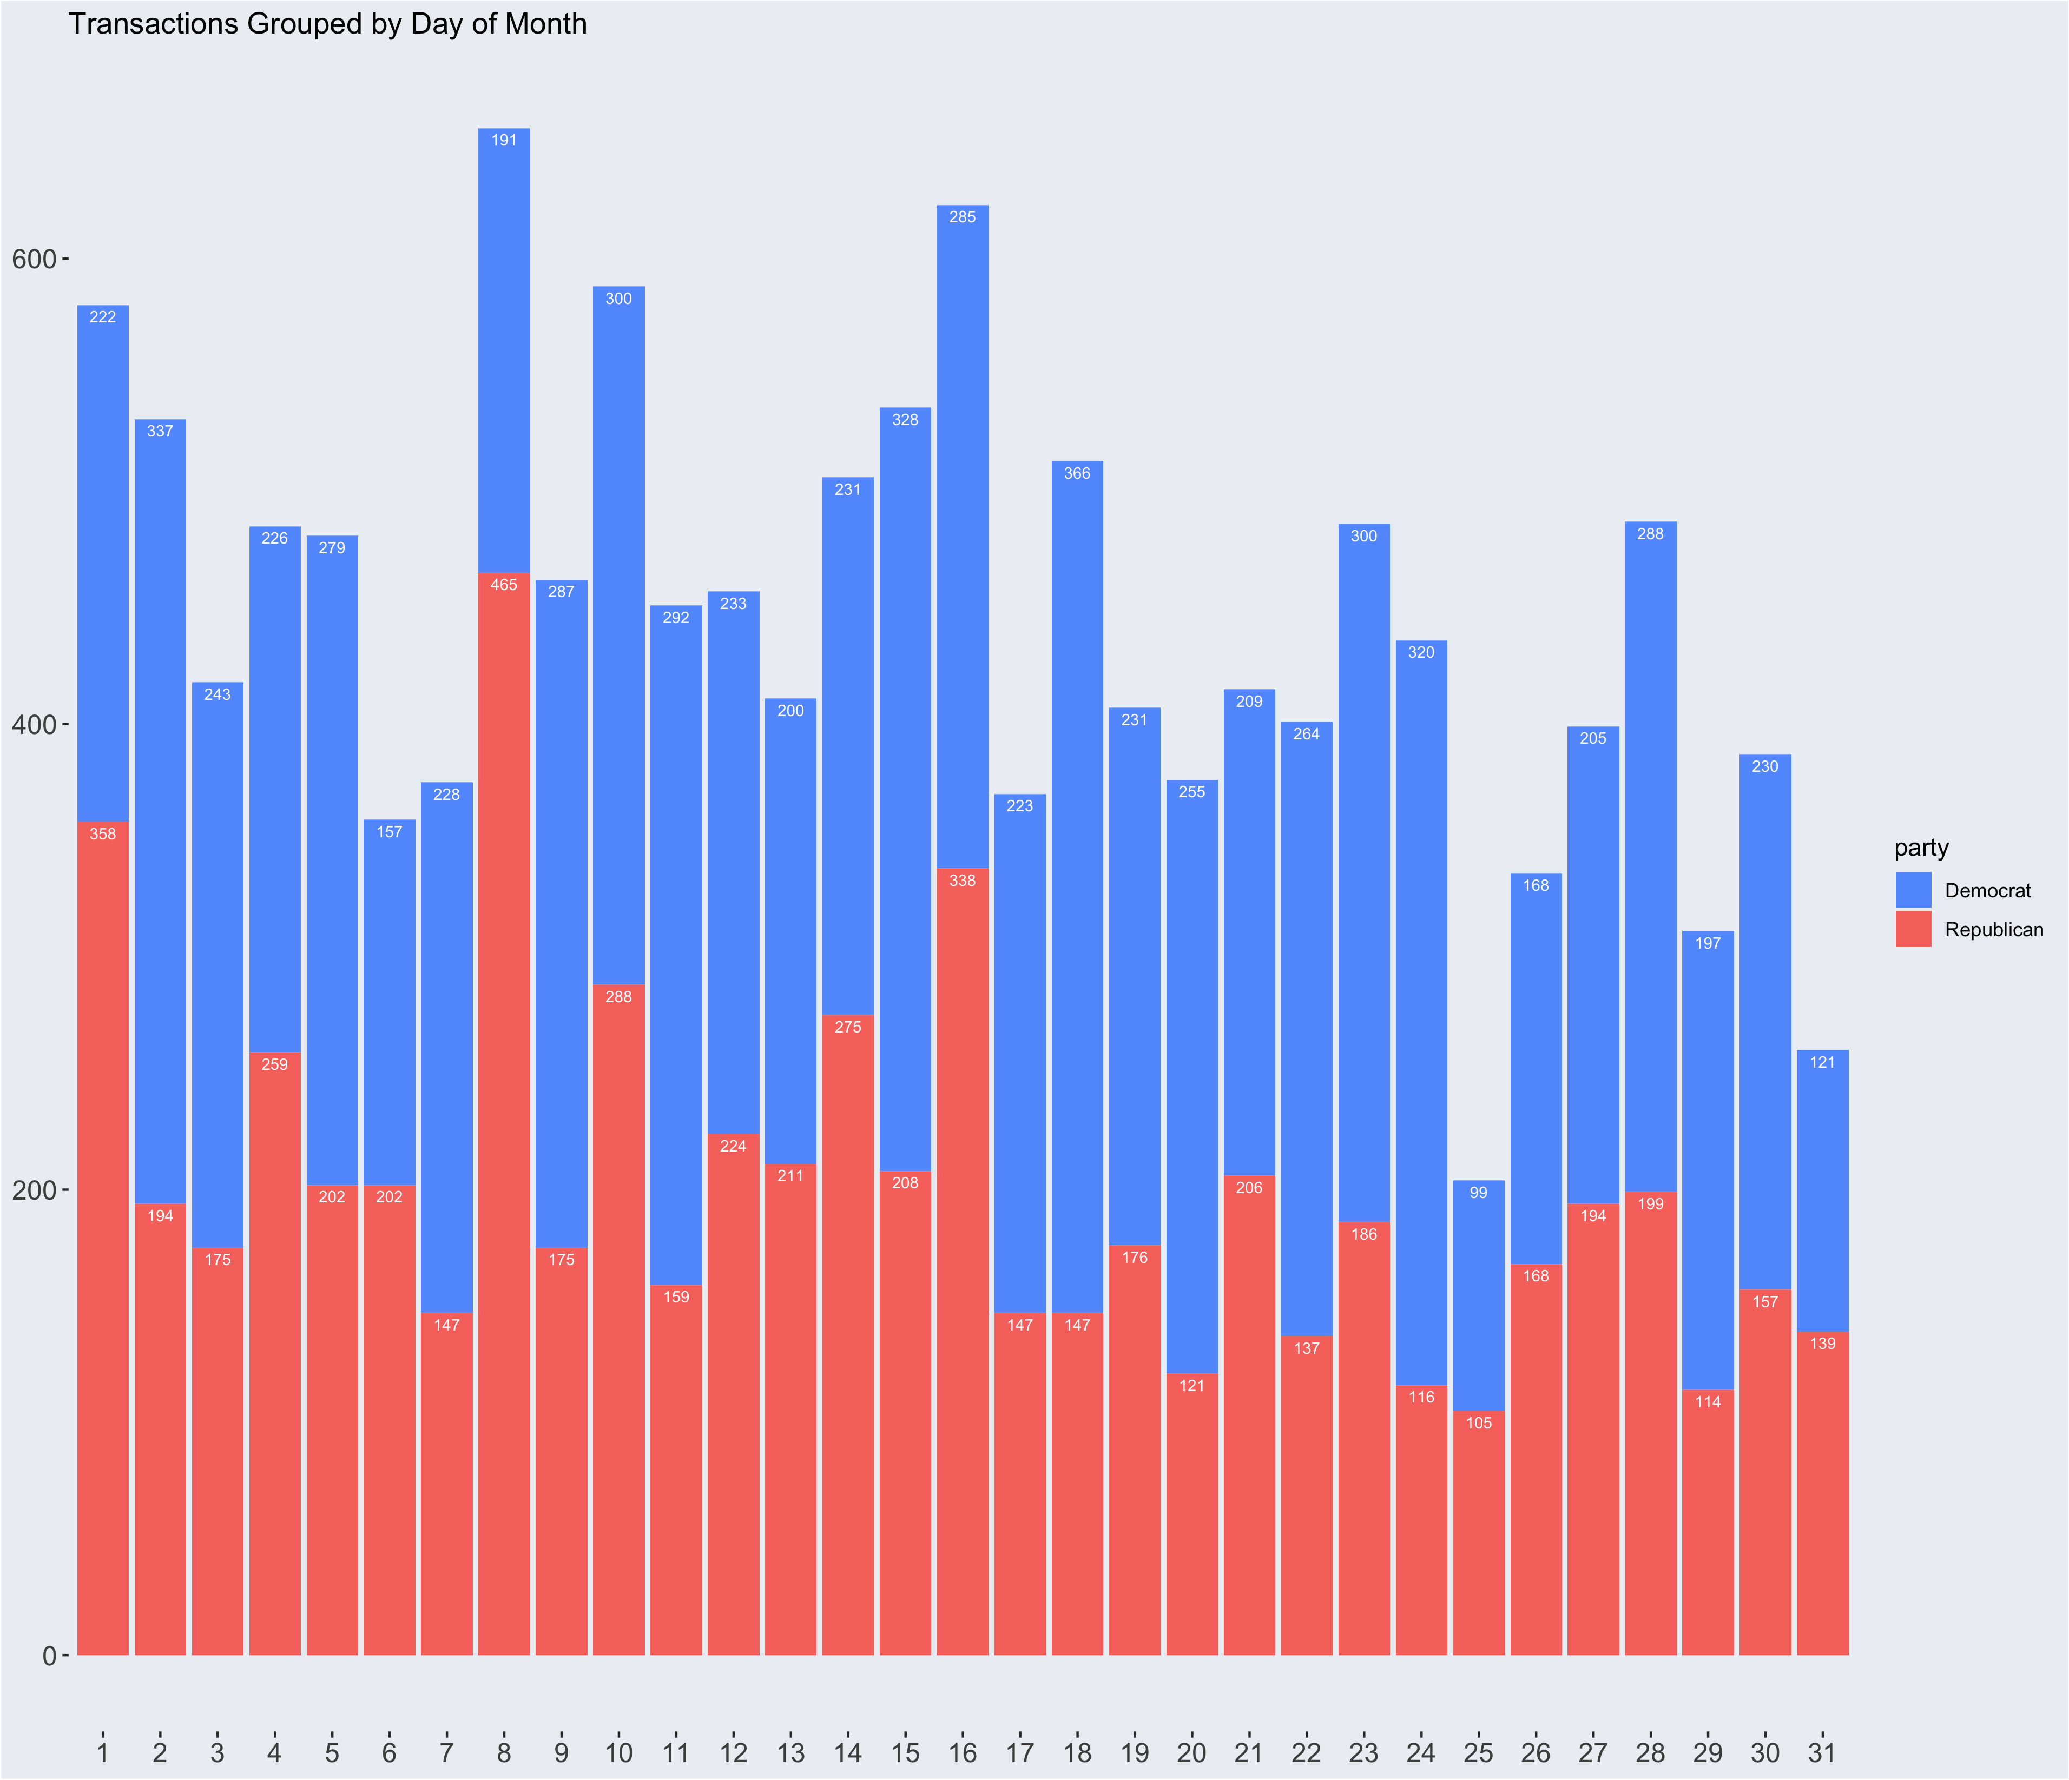
Notes:
Here it is grouped by day of the month, with the most popular days of the month being the 1st, 8th, 10th and 16th

Slide 13
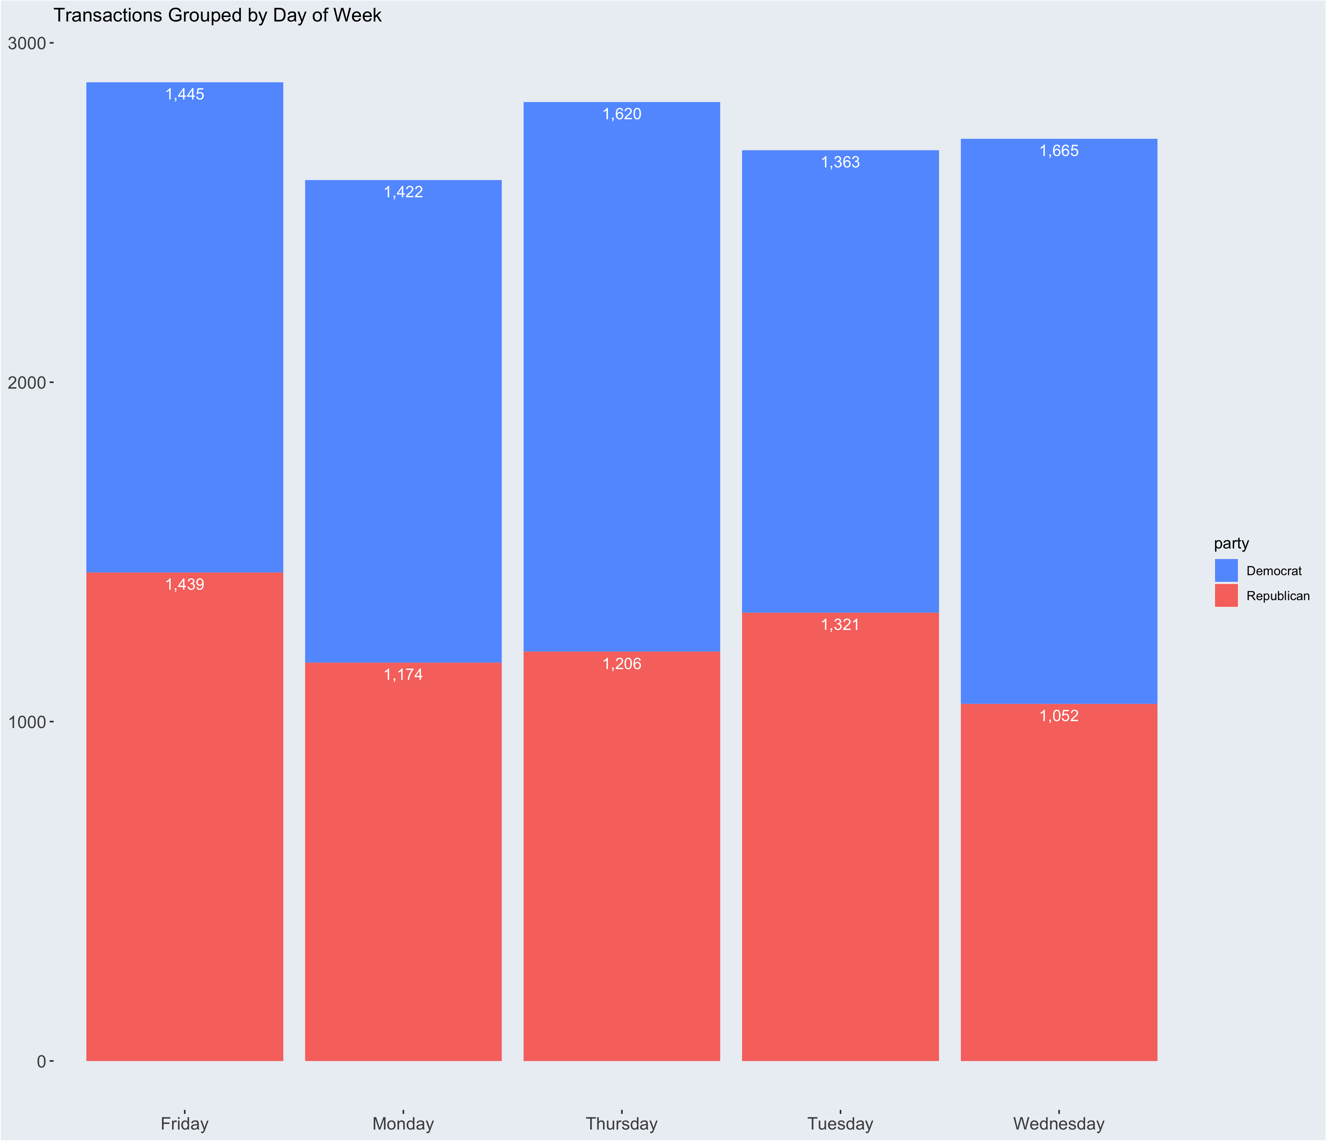
Notes:
And here is a graph grouped by day of the week, Of which not much insight can be taken

Slide 14
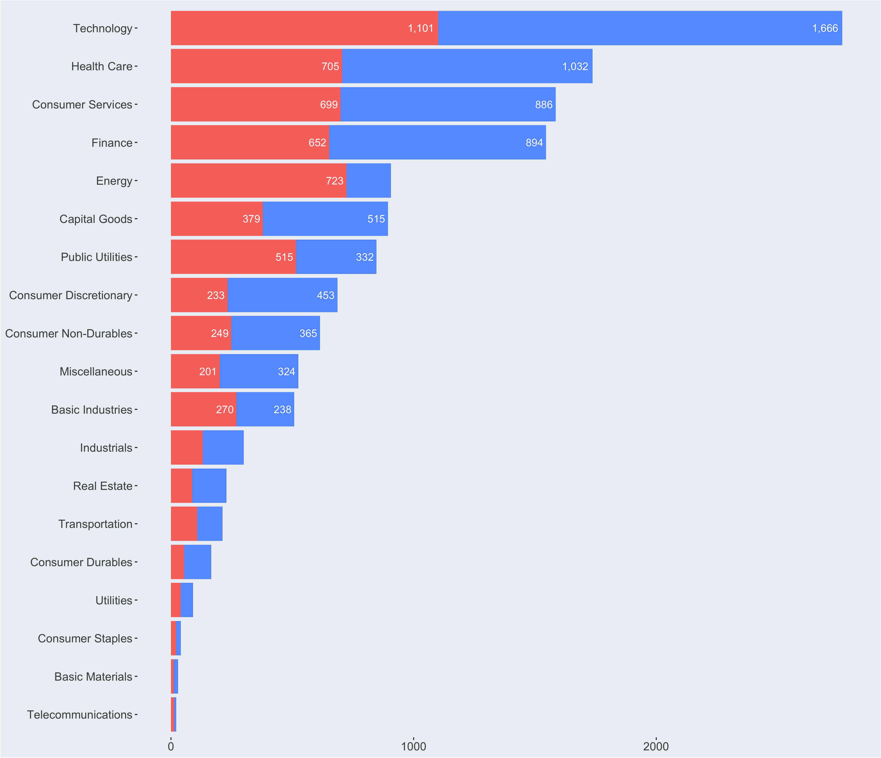
Sectors
Notes:
I then thought it would be interesting to graph the transactions grouped by what sector the stock was in.
There is obviously a big focus on Tech stocks, as they make a large portion of the S&P 500 anyway, so APPL META GOOG tend to be stocks that every one is trading,
however It’s interesting that Healthcare is SO high up there, along with finance, energy, and public utilities, all of which are deeply entrenched in the day to day of government committees.
Another interesting insight to take from this visualization is what parties are trading more of than the other. Republicans are MUCH more interested in Energy stocks than Democrats, along with public utilizes and “basic industries.”
Everywhere else, the democrats traded more frequently overall, so it would make sense that their counts are higher.

Slide 15
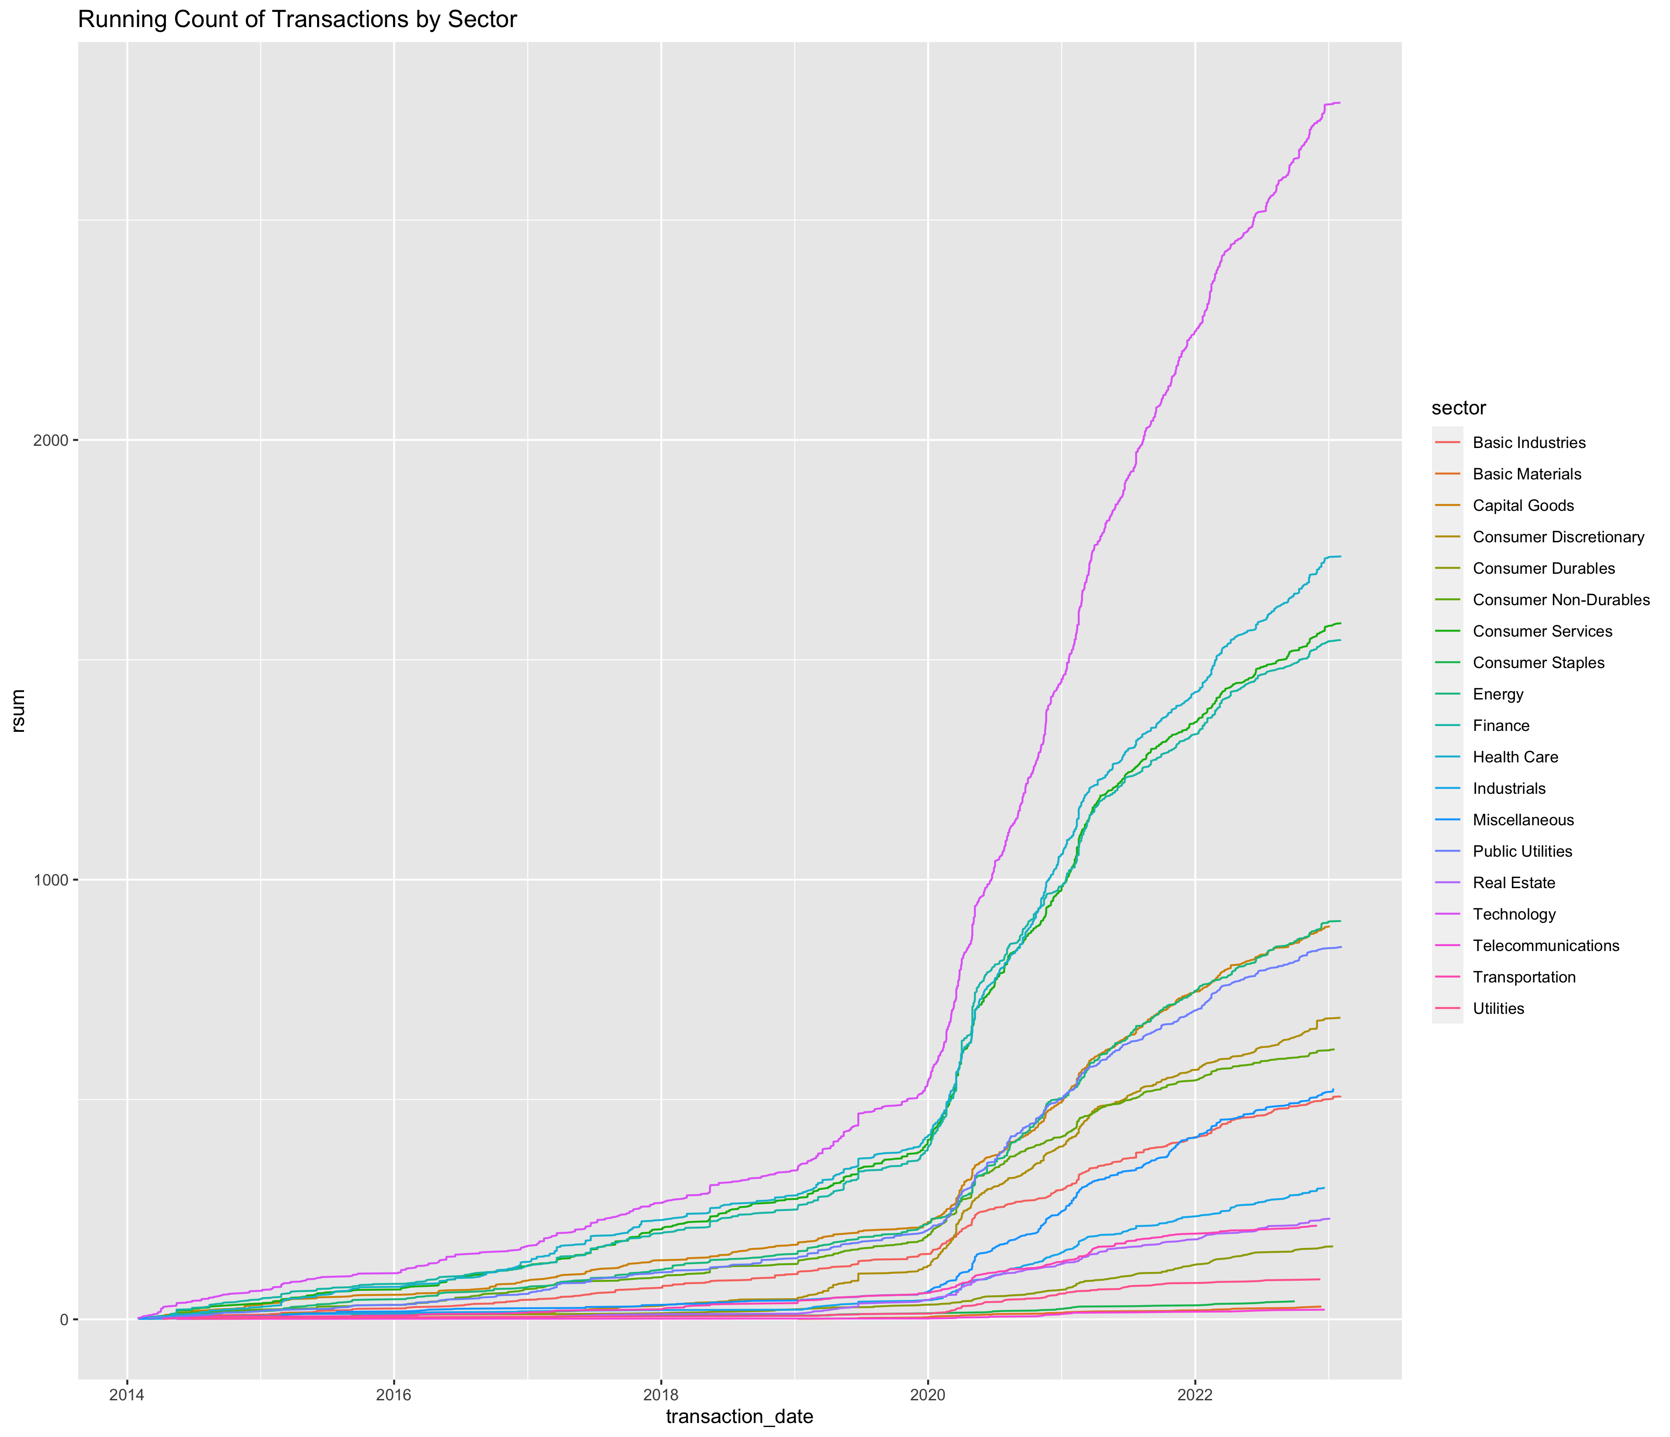

Slide 16
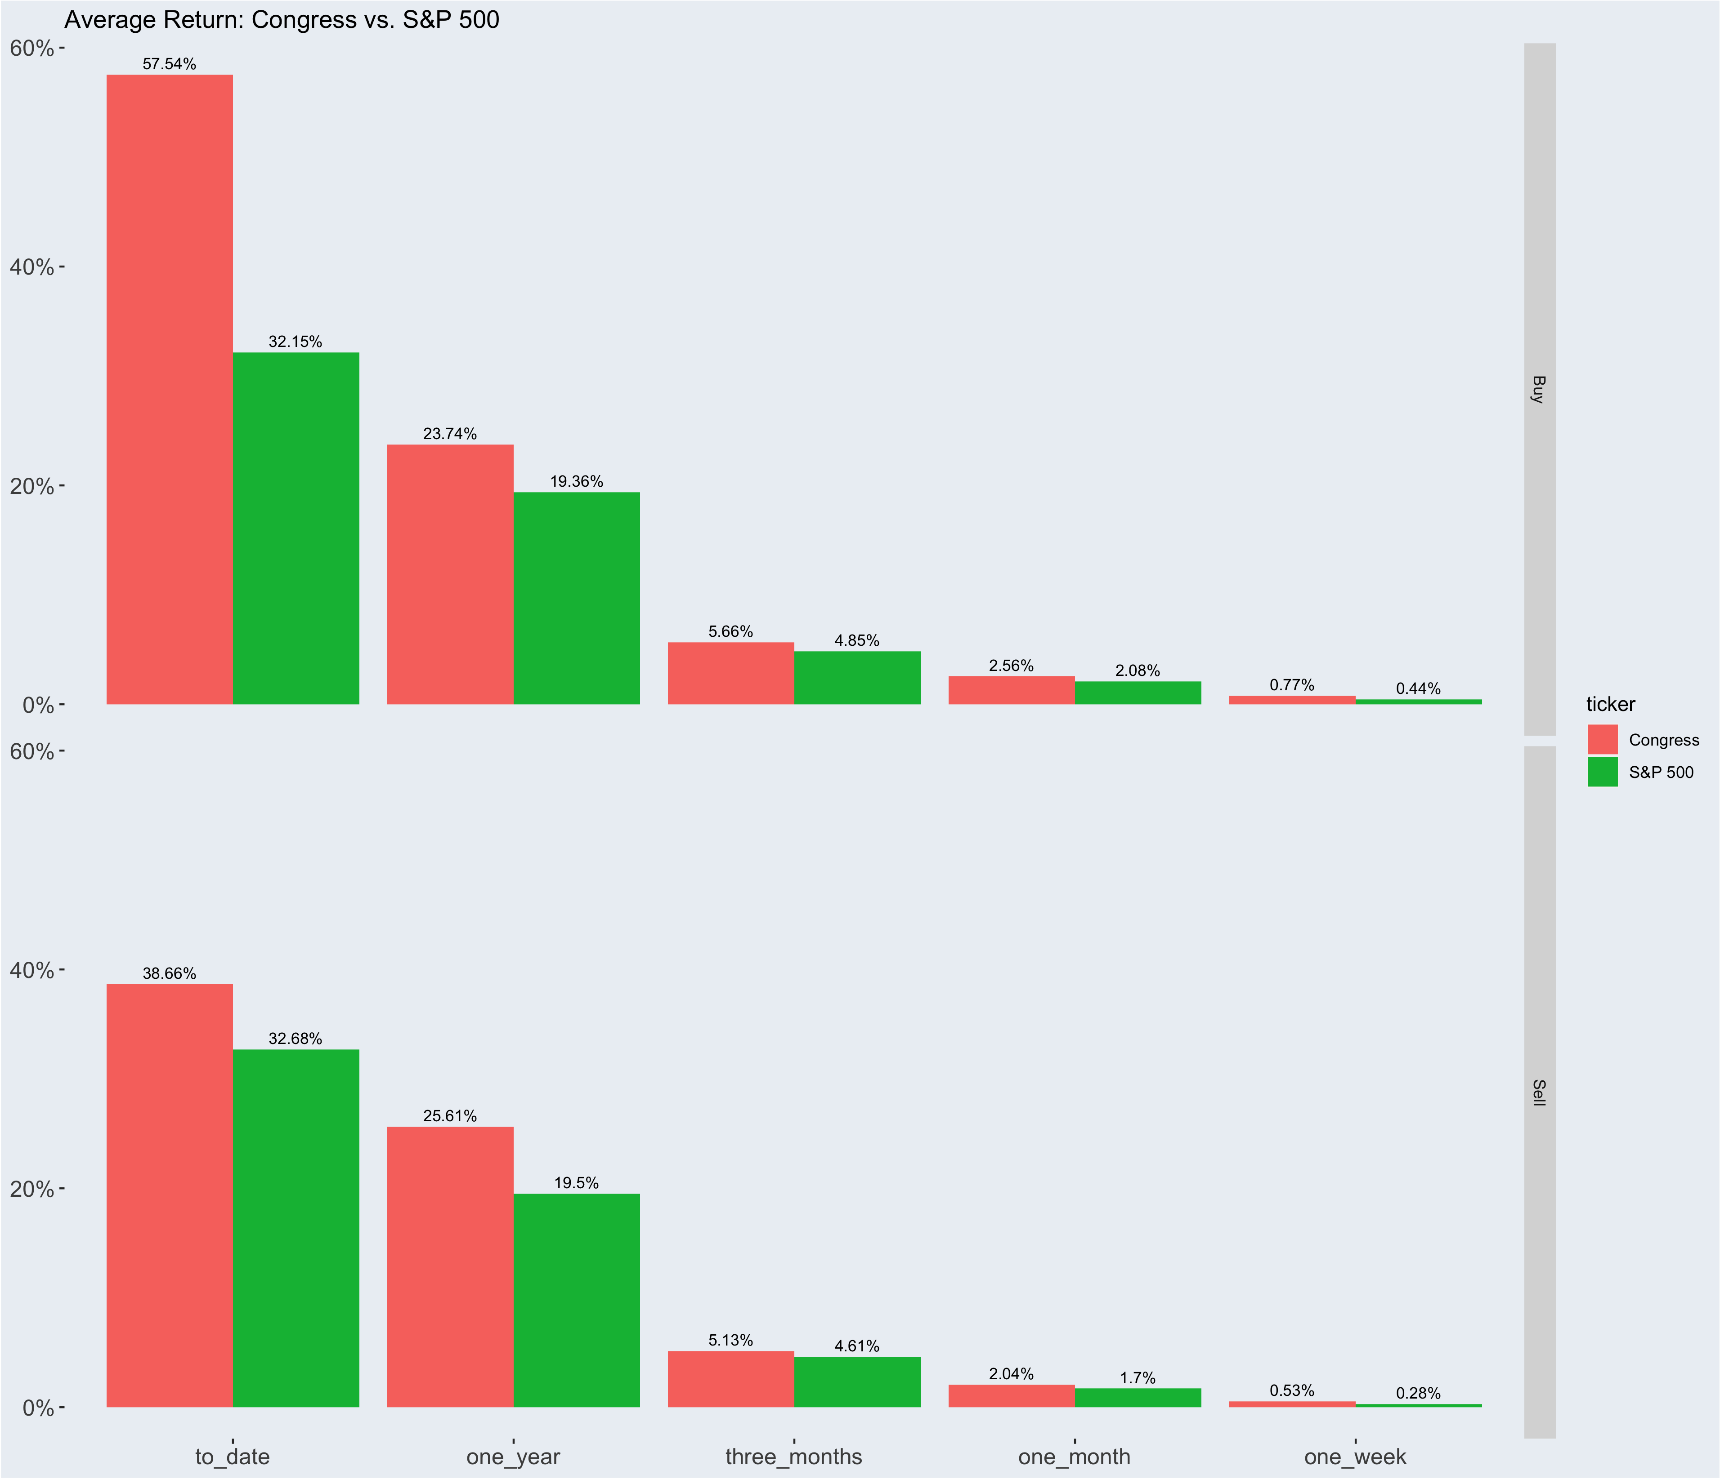

Slide 17
Notes:
So here the story is all about timing.
Comparing the performance of the government as a whole to the performance of the S&P 500, ALll across the board, the GOV beat the S&P 500. One month by .48%, three month by .81% and one year by 4.38
­

Slide 18
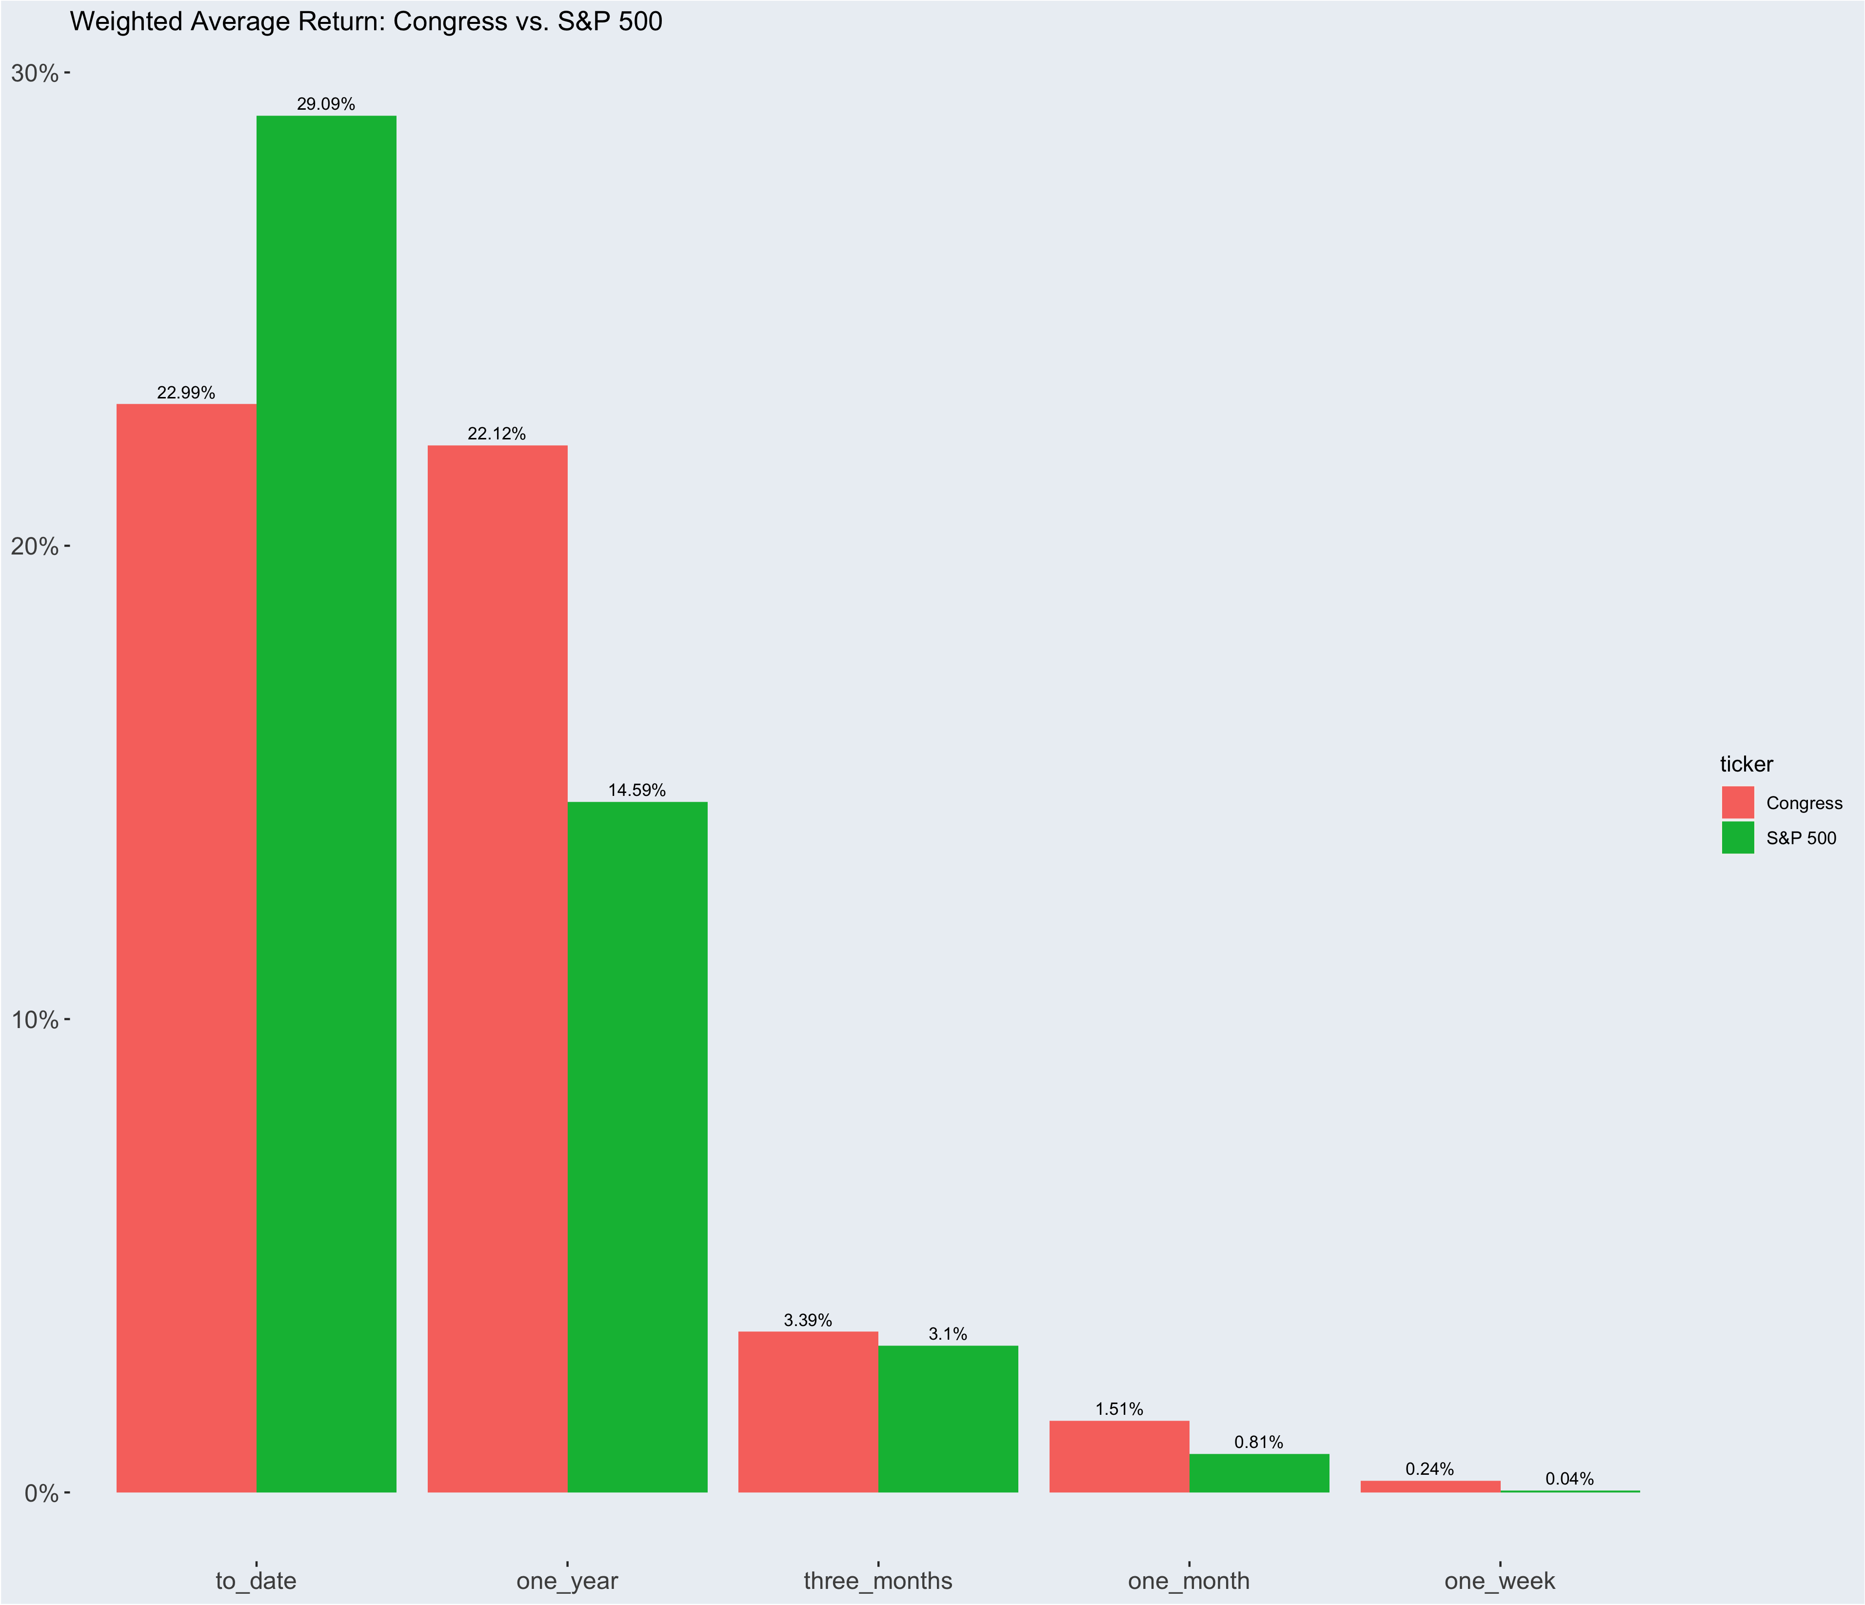
Notes:
Now that I have provided a summary of the data set, I then analyzed the performance of congress.
In order to analyze the effectiveness of Congressmembers trading stocks, I used the appended coluimns I added and created a story all about TIMING the Market,.
Since only the range is available, and not exact amounts, For all 16k transactions I took the transaction date and the ticker that was provided for each transaction. I then appended the value of that ticker, 7/30/90/365/ and to date after the transaction date.
I then assessed percentage change between the price of the stock at the time traded and price of the stock in the time frame after.
So here you can see a graph, showing congress compared to the S&P 500 to see who is better at TIMING the market.
On all time frames, it looks like Congress beats out the S&P 500 except for the to_Dtae time frame.
This reminds me of a famous finance tale of a wager that Waren Buffet took against a hedge fund in the late oughts.
Warren buffet made a bet in 2008 with protégé partners hedge funds that over the course of 10 years, a simple S&P500 etf would beat out any strategy that the hedge funds managers could through it it.
In the short term the Hedge Funds was the clear front runner, especially with the 2008 financial crisis, however, it turned out to be a classic story of toroise and the hare, where the ETF returned %85% over 10 years and of the 5 strategies the hedgefund put together the largest return was 62.* percent return, but really between the 5 averaged 22%.
This Exact scenario is playing out here: Congress members when buying stocks, on average(weighted based on volume) are able to beat out the S&P 500 up to a year, but past the year mark, if they had bought and held to_date, then they would have just been better off buying the S&P 500.
However!
There is a further complication here!
In terms of assessment of timing the market, it’s not ALWAYS a good thing that the price rises.
For example, If you were to buy a stock and it went up in the month or so following, that would be a well timed BUY.
HOWEVER if you sold a stock and it rose in value in the months following, it would be a poorly timed trade.
My chart currently doesn’t consider type of transaction as a factor, so let’s break this up further by transaction type: buy or sell

Slide 19
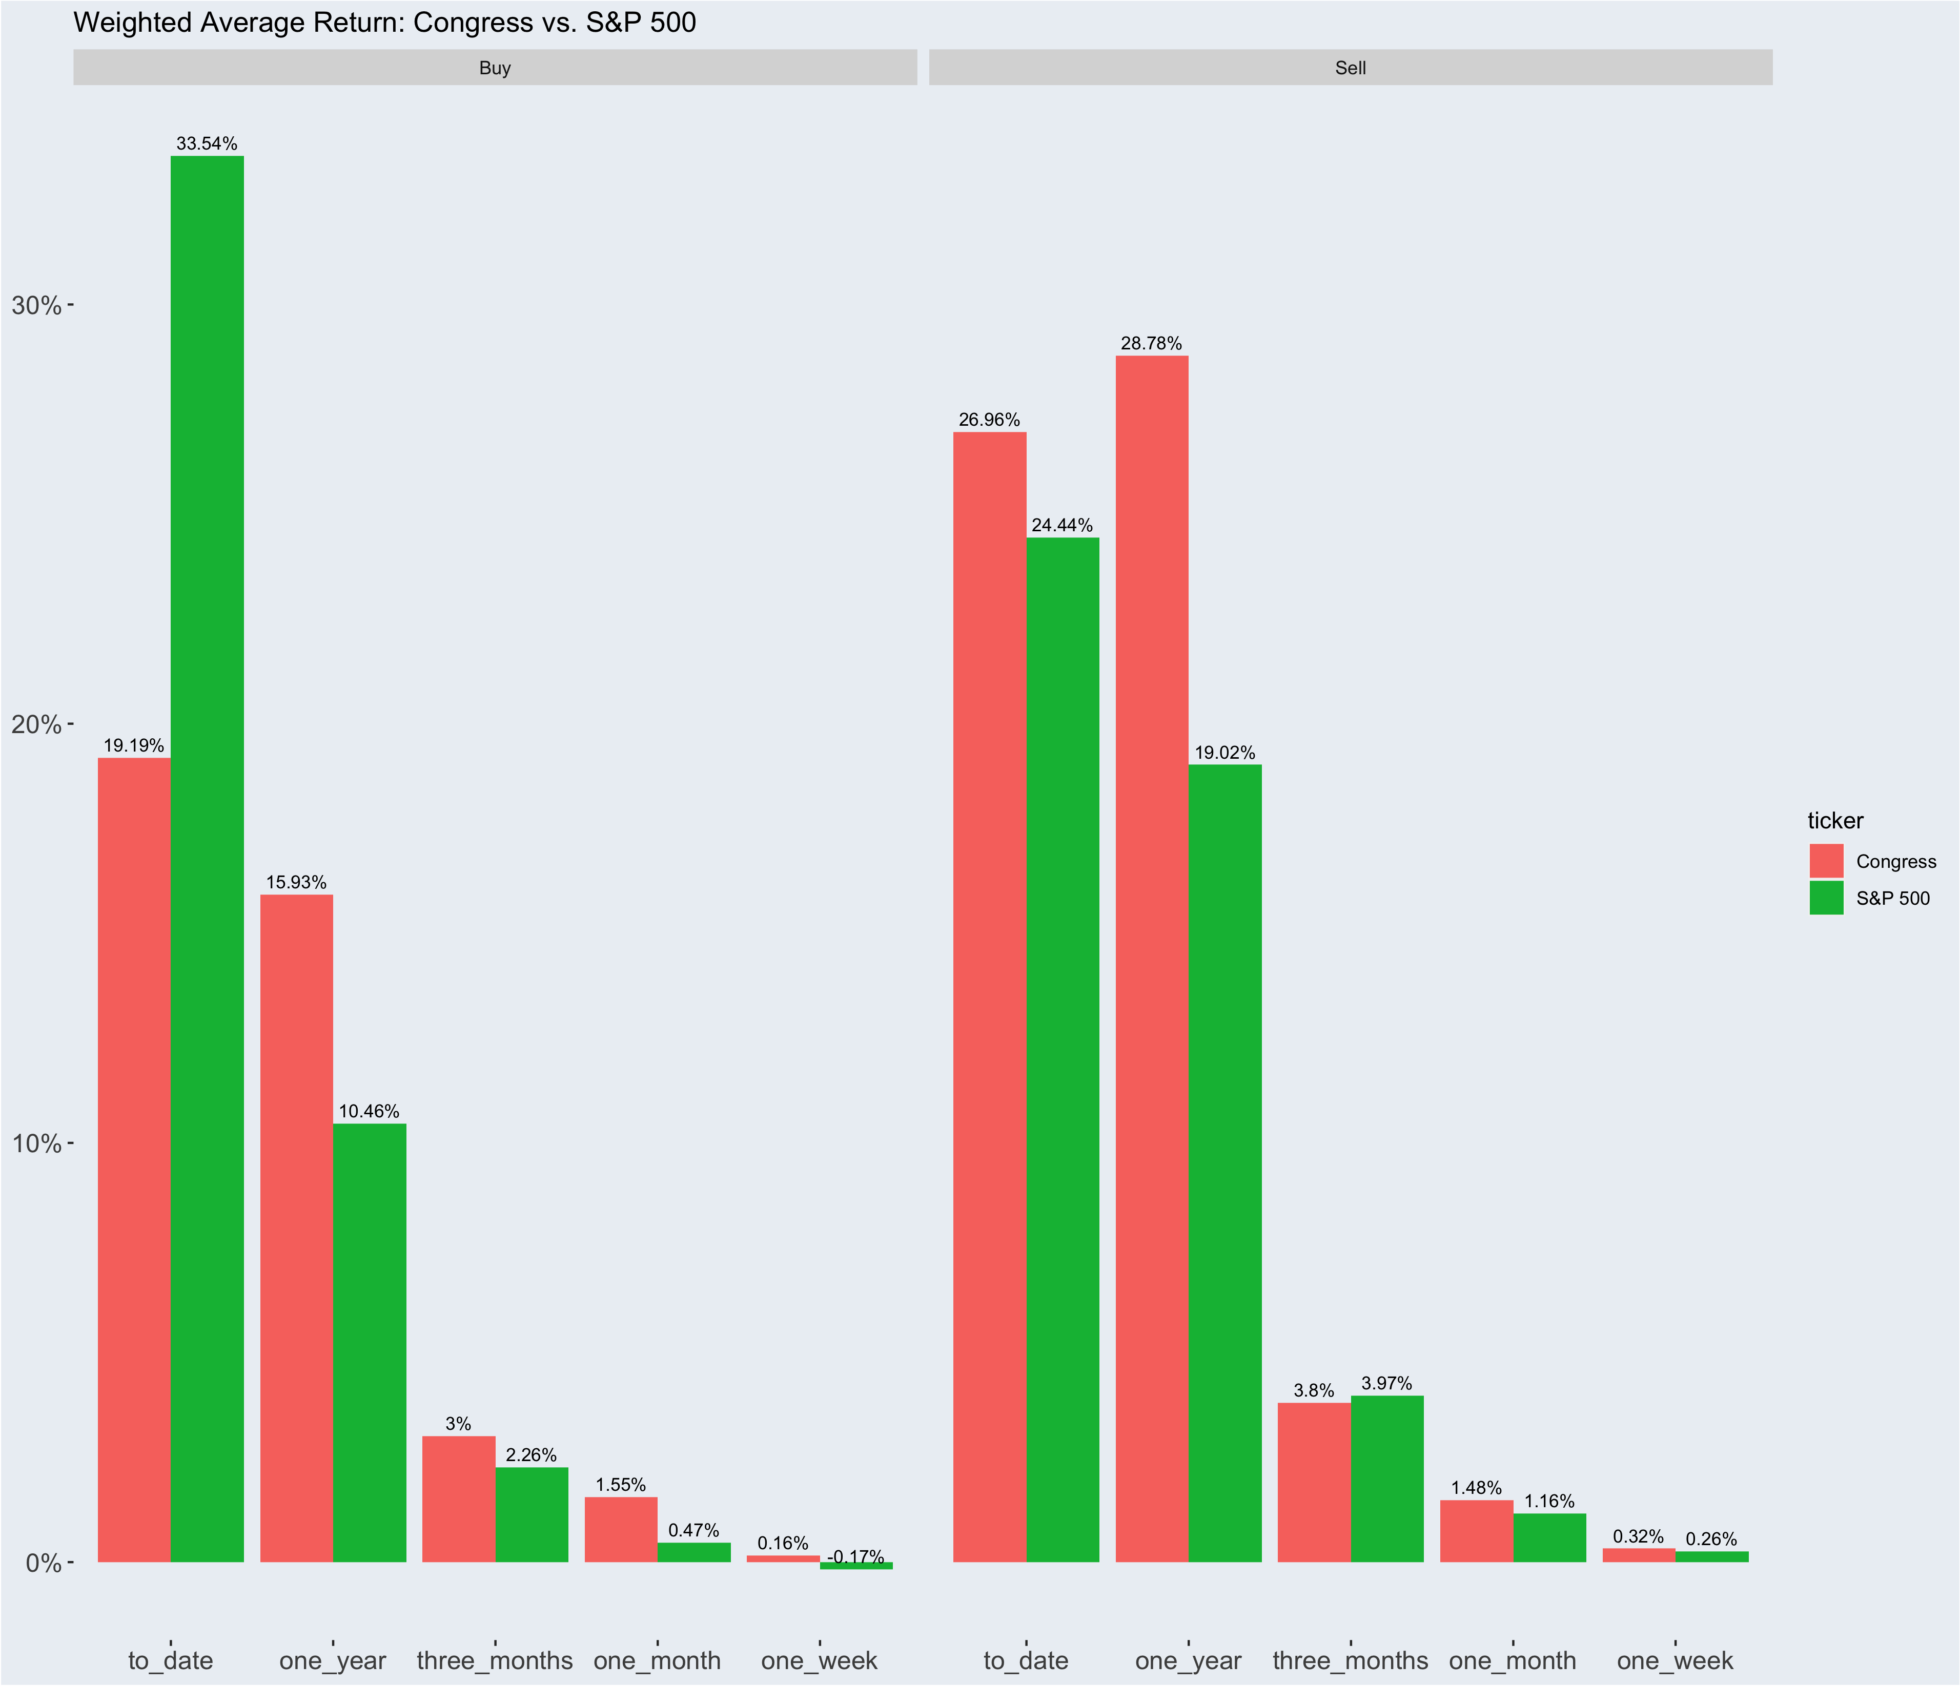


Notes:
In this graph, I facetted the data by transaction type. So now you can clearly see a performance break down of Congress trades, vs. the S&P 500.
With Buy data, If the % value is higher, that means that Congress bought stocks, and they rose higher than if they had bought the S&P 500
With The Sell Data, we are looking for LESS of an INCREASE. The reason I phrase it that way, is because stocks…over a period of time, typically rise on average. Annecdotally, one year after each of the transaction dates only 28% of transactions were less than their original value
So with Sell Data the lesser number is the better number
(TALK RESUTLS)
BUY SIDE
Click
SELL SIDE
SO: Overall here congress is really good at timing BUYS and not as good a timing the sells, compared to the S&P 500.
In terms of timing the market with selling, the Government performed much poorer than then if they were holding the S&P and sold that. The only time is when they beat out on average 3 months after the transaction date, every where else, the S&P500 rose less than the Gov trades.
However, I’m interested in an even FURTHER breakdown. I want to know if Democrats, or Republicans are better at timing the market.
So let’s Facet by transaction type AND by Party.

Slide 20
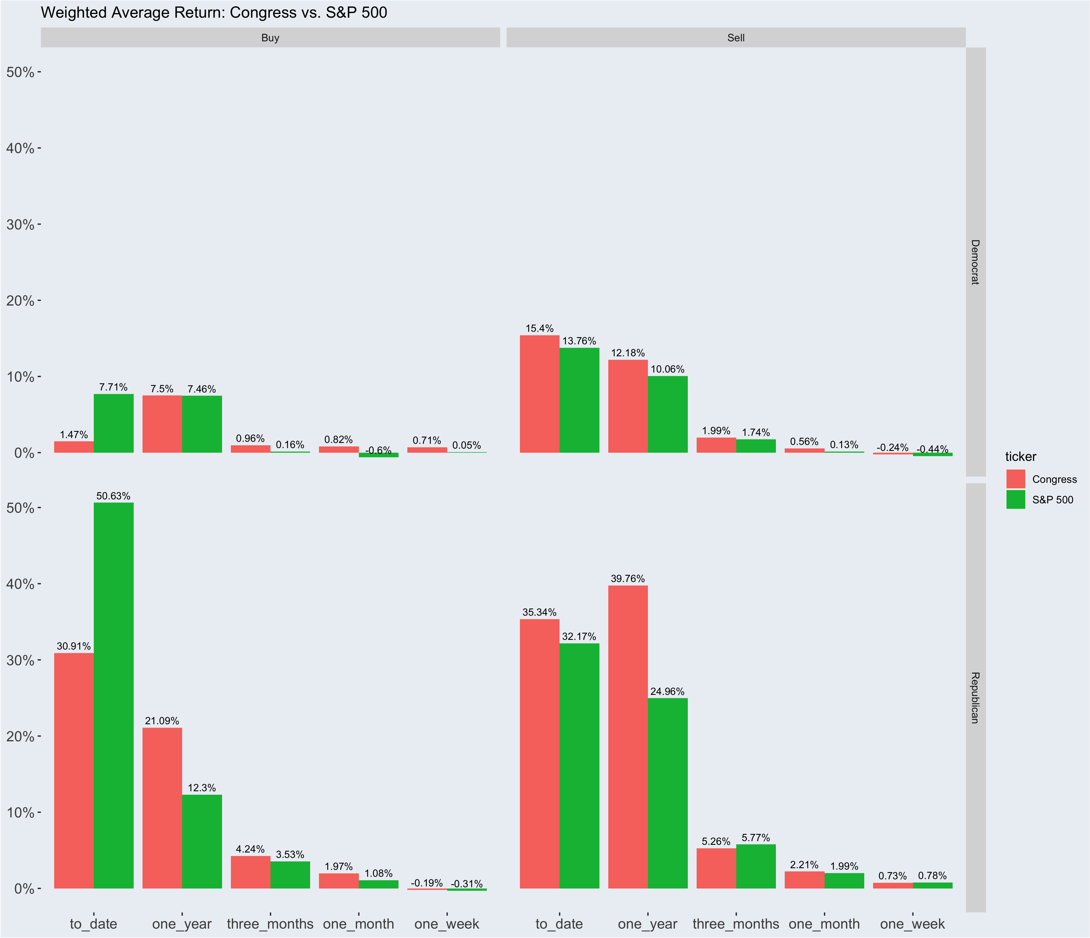
Notes:
On the Right Side are the Party’s and the Top is Buys/Sells
There is a MASSIVE Gap in performance between Democrats and republicans.
But the trends between the two are relativelively similar as last time. In the buying Category, fcongress beats out the S&P 500, except in the to-Date category.

Slide 21
Individuals

Slide 22
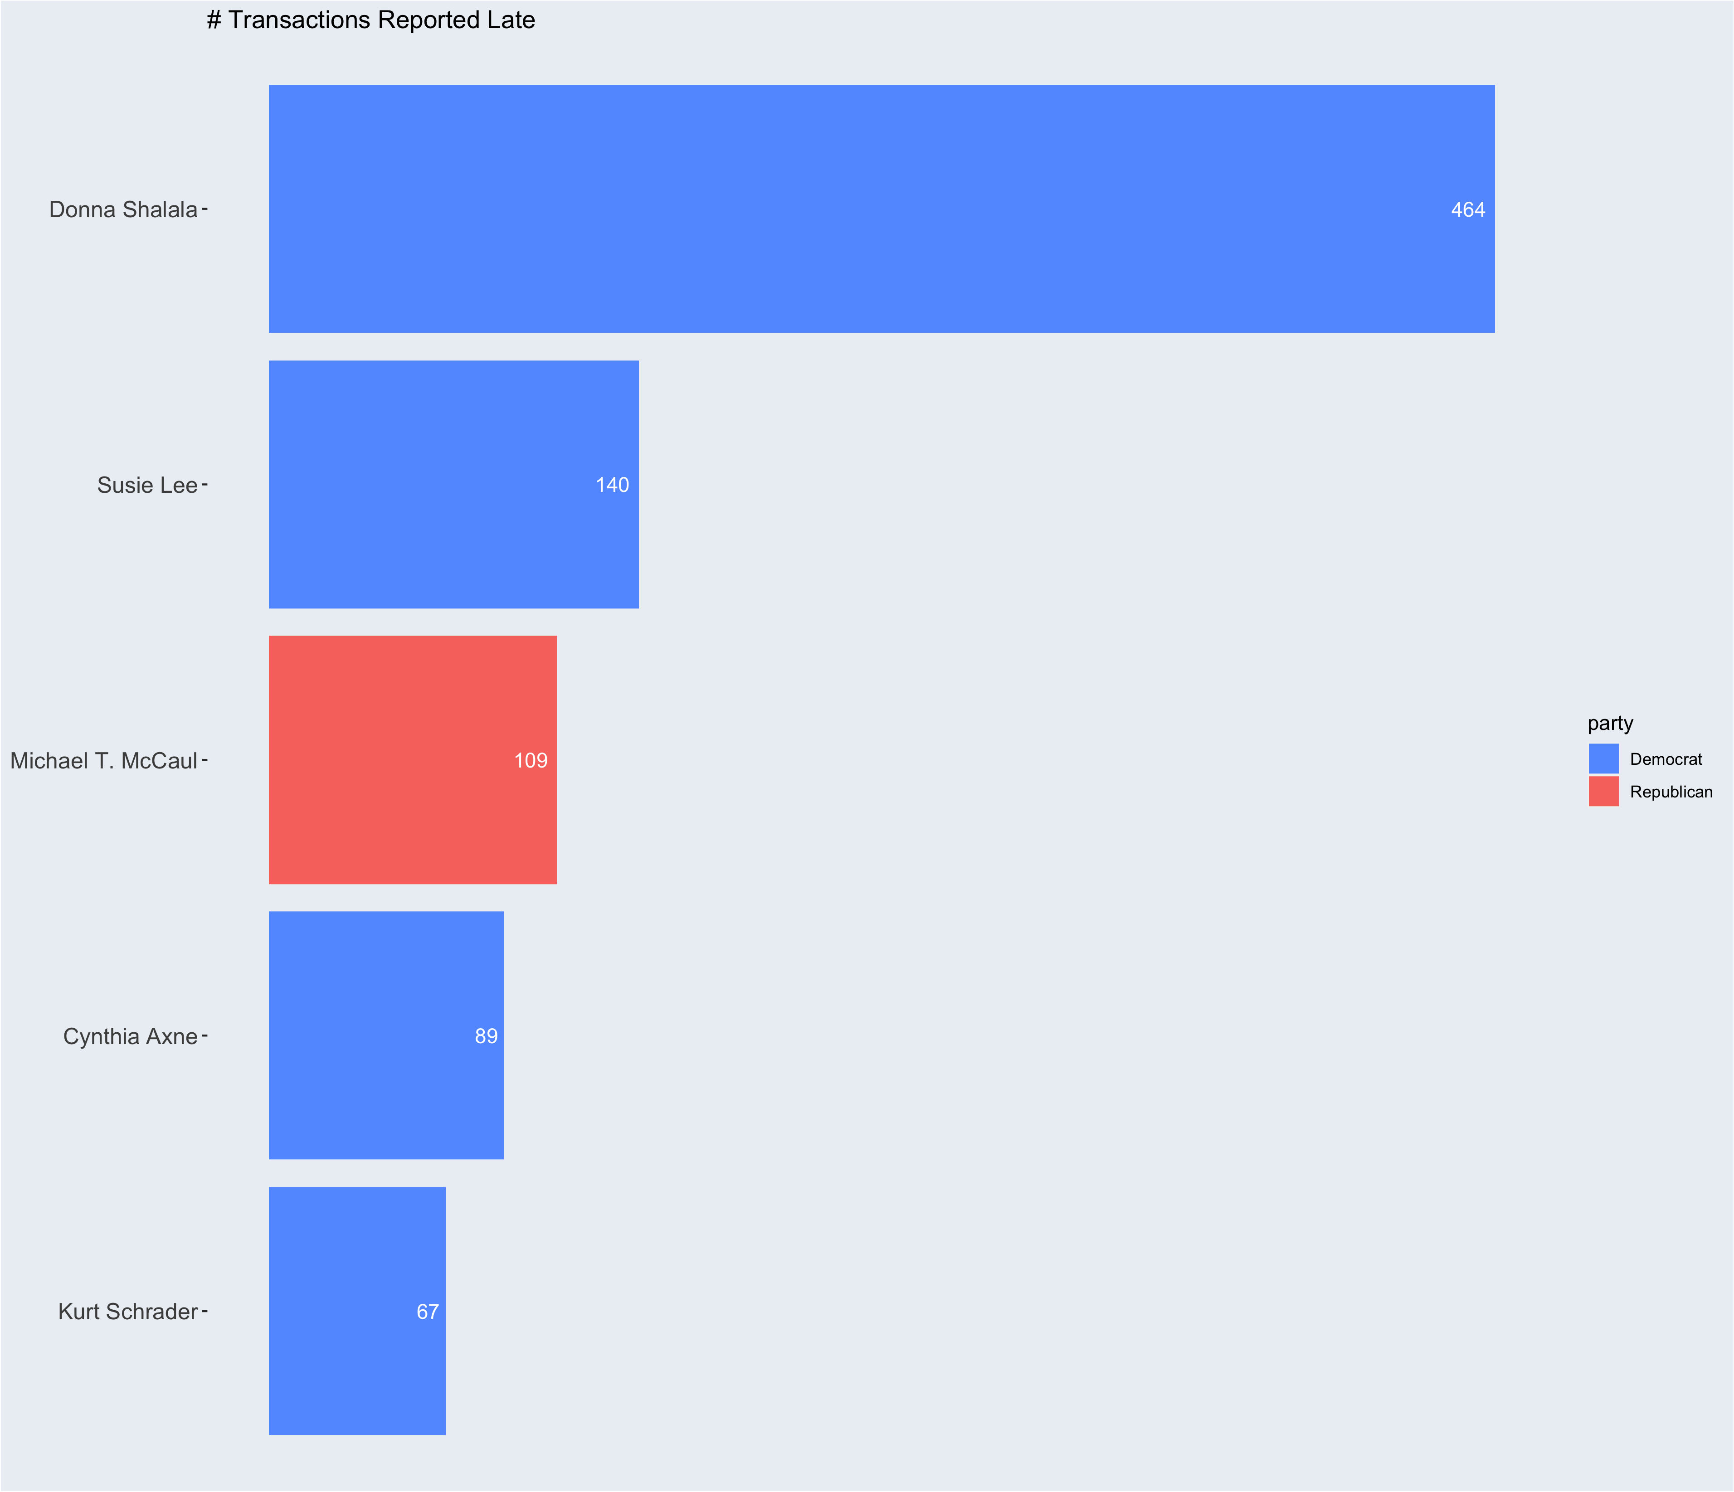
Notes:
Okay, so now that we know the government trade trends as a whole, let’s start looking into some individuals.
I’ll begin with who we should avoid for any sort of TIMELY advice. These are the top 5 people worst reported transactions late. Donaa, reported 464 transactions late. So timely advice is not her strong suite.
Representatives are required to report transactions before 45 days after the transaction. However, the average delay was 57.25 days, the max delay was 1640 days and the min delay was 1 day. There were 1,883 transactions and 85 representatives that reported late. Of those reps, the top 5 egregiously do not follow that rule. Of all 1883 transactions, NO ONE left a comment in the form saying why it was late. Only 375 used the comment part of the form anyway
https://www.businessinsider.com/congress-stock-act-violations-senate-house-trading-2021-9
In These particular Examples,
Donna Shalala Blamed it on an adcminstrative error, and was not fined. (https://thehill.com/homenews/house/494183-shalala-i-take-full-responsibility-for-failure-to-disclose-stock-sales/)
Susie Lee blamed them on clerical errors, and didn’t receive any fines. (https://nevadagop.org/icymi-rep-susie-lee-a-democrat-from-nevada-failed-to-properly-disclose-stock-trades-worth-as-much-as-3-3-million/)
Michael McCaul TX-R (It was mostly his wifes transactions that were reported late, and there were no fines)
Cynthia Axne IA-D: clerical error(https://www.desmoinesregister.com/story/news/politics/2021/09/23/watchdog-campaign-legal-center-wants-ethics-investigation-iowa-rep-cindy-axne-over-stock-trades/5827271001/)
Kurt Schrader OR-: No statement and no fine (https://www.businessinsider.com/congress-stocks-kurt-schrader-oregon-2022-2)
Members of Congress face a $200 fine for failing to disclose their stock trades on time, but the Committee on House Ethics does not assess a fine for first-time STOCK Act disclosure provision violators if they're late by 30 days or fewer. Schrader's late stock disclosures fell within this "grace period," meaning he will avoid a fine.

Slide 23
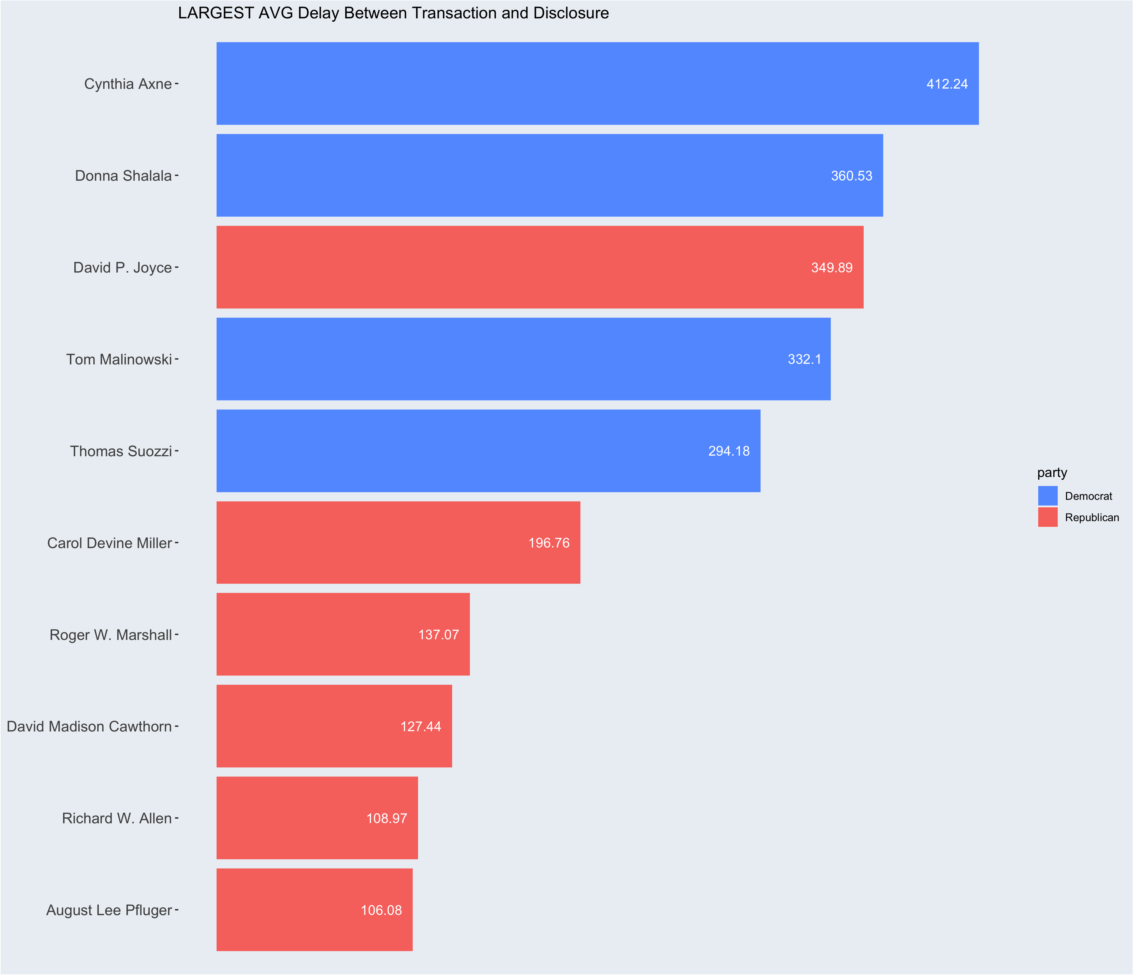

Slide 24
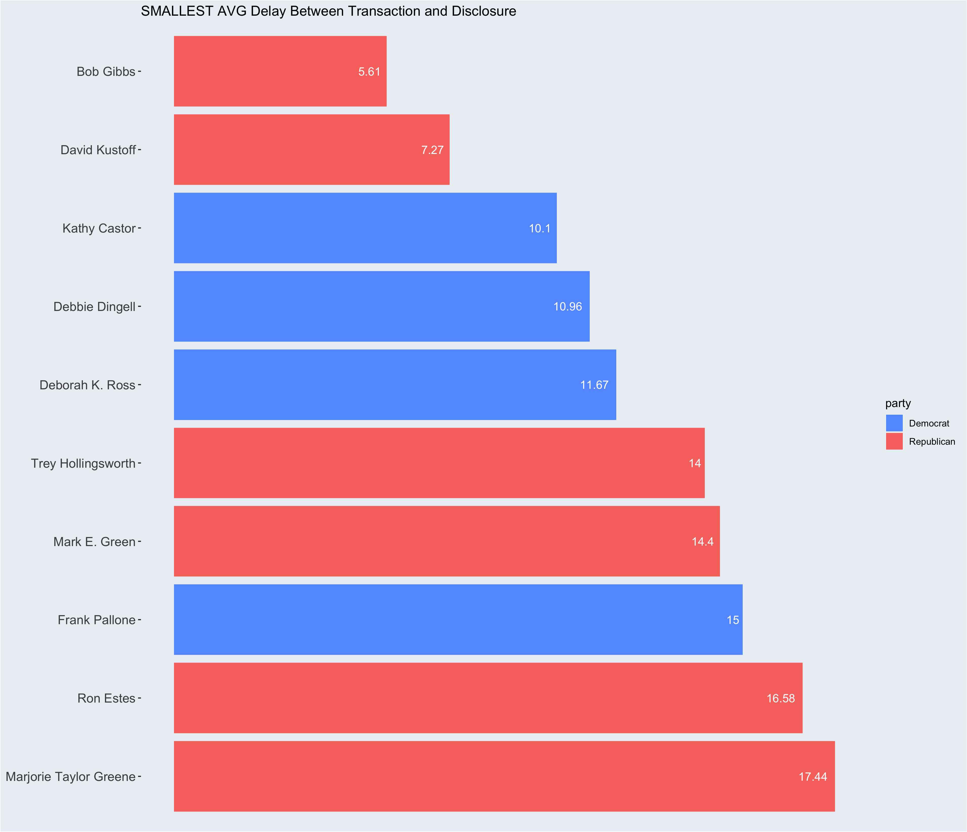

Slide 25
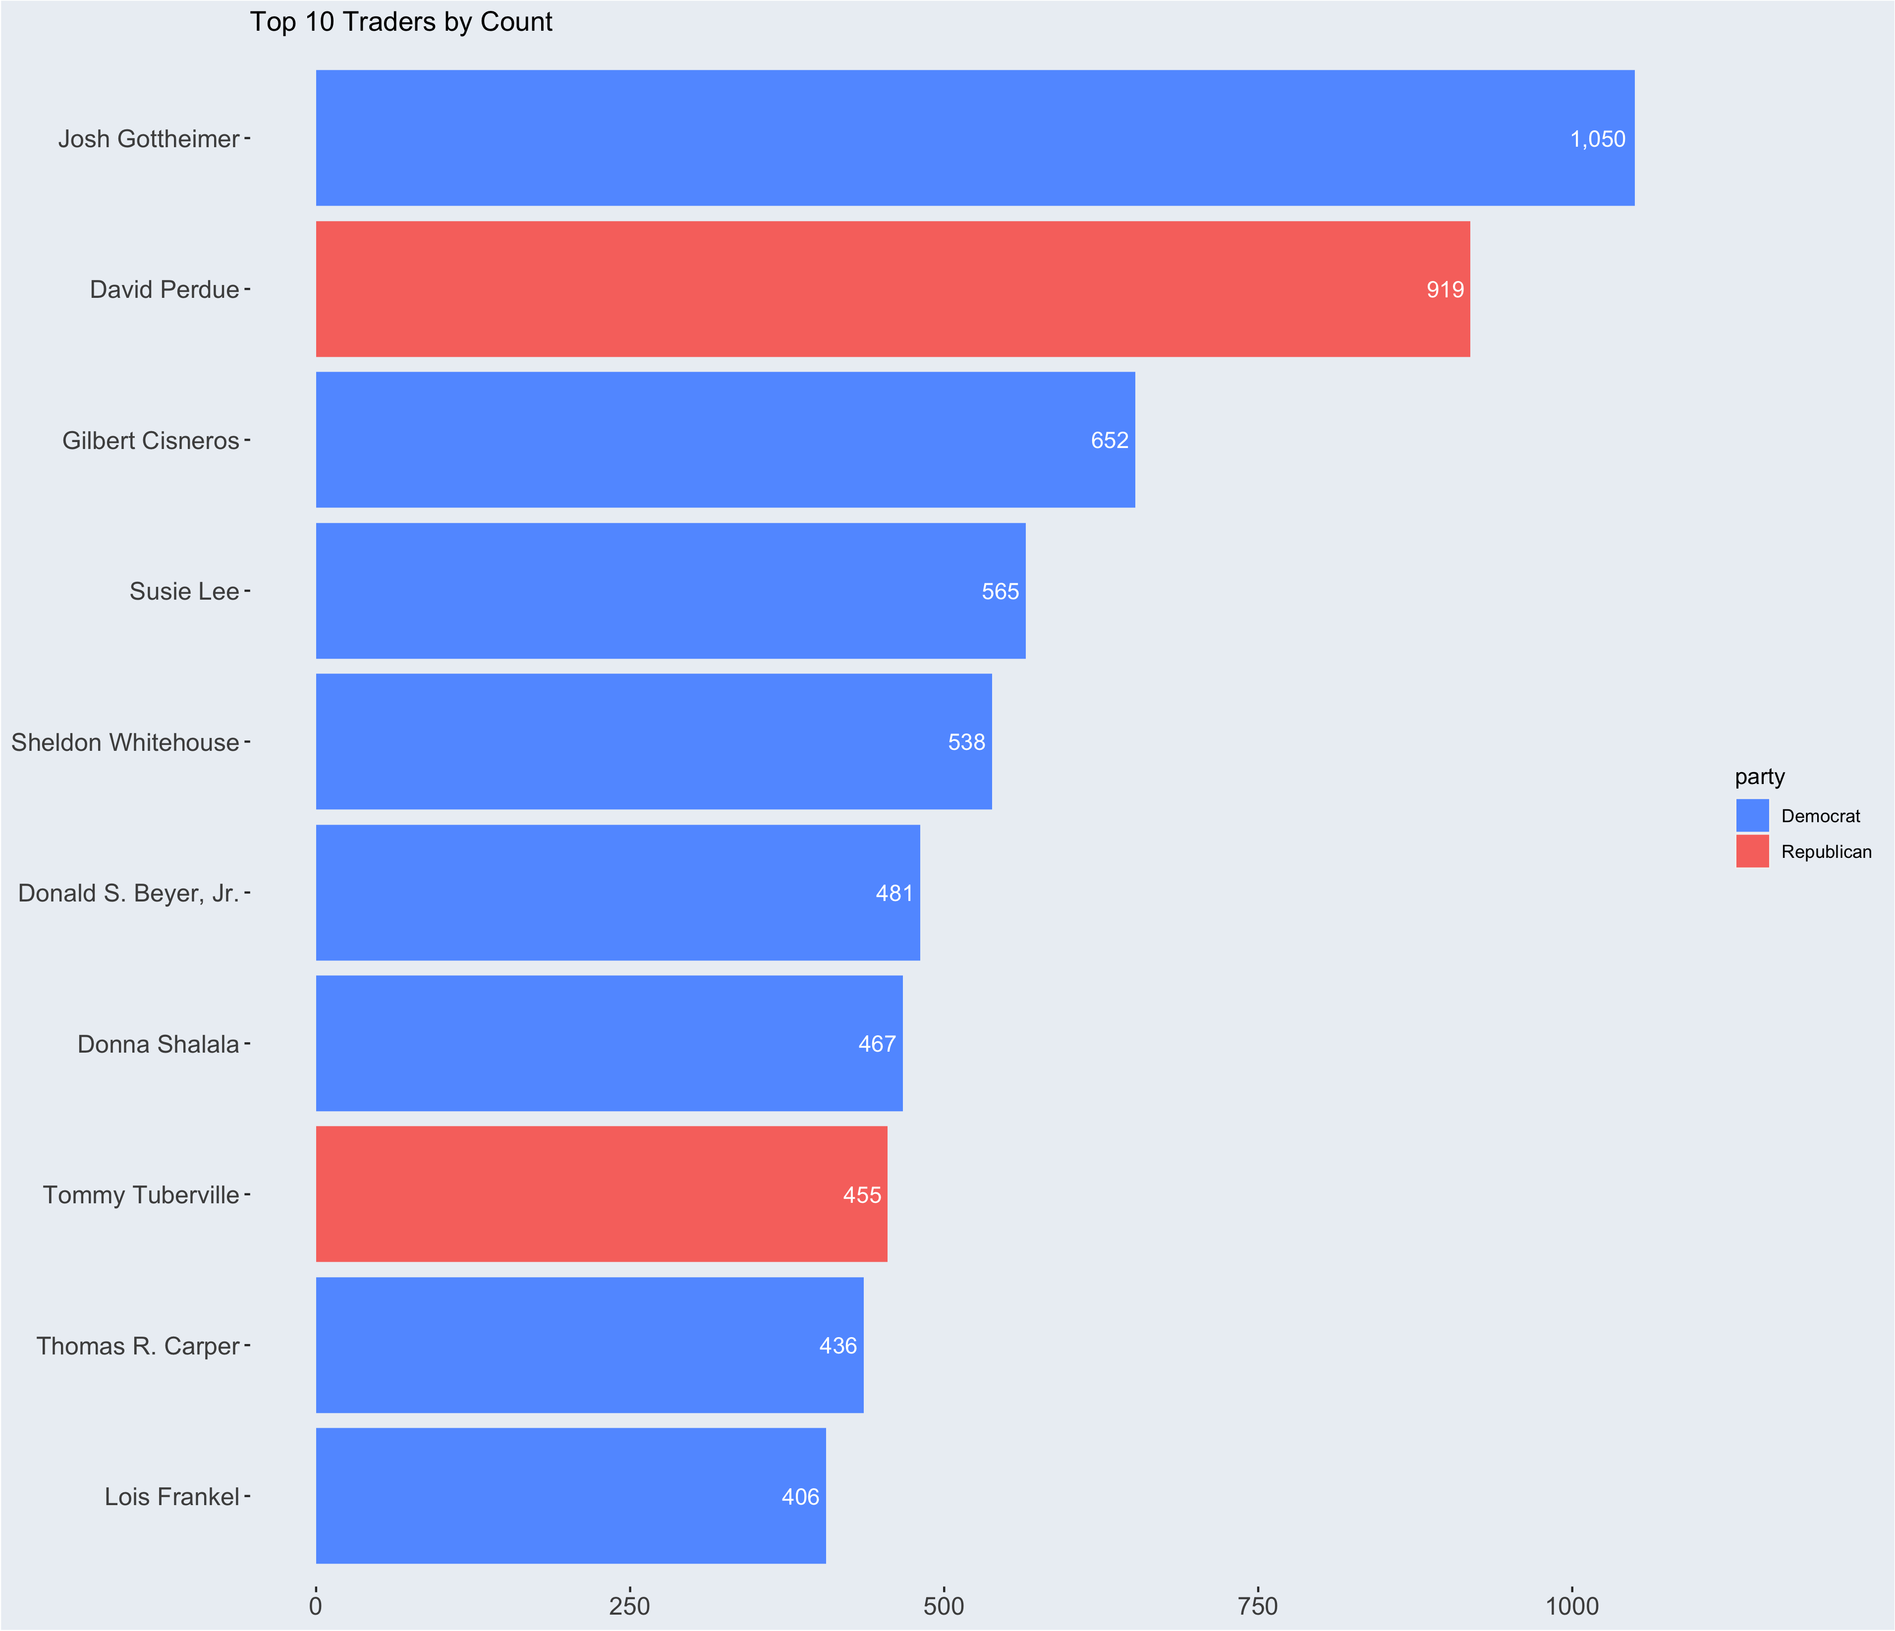
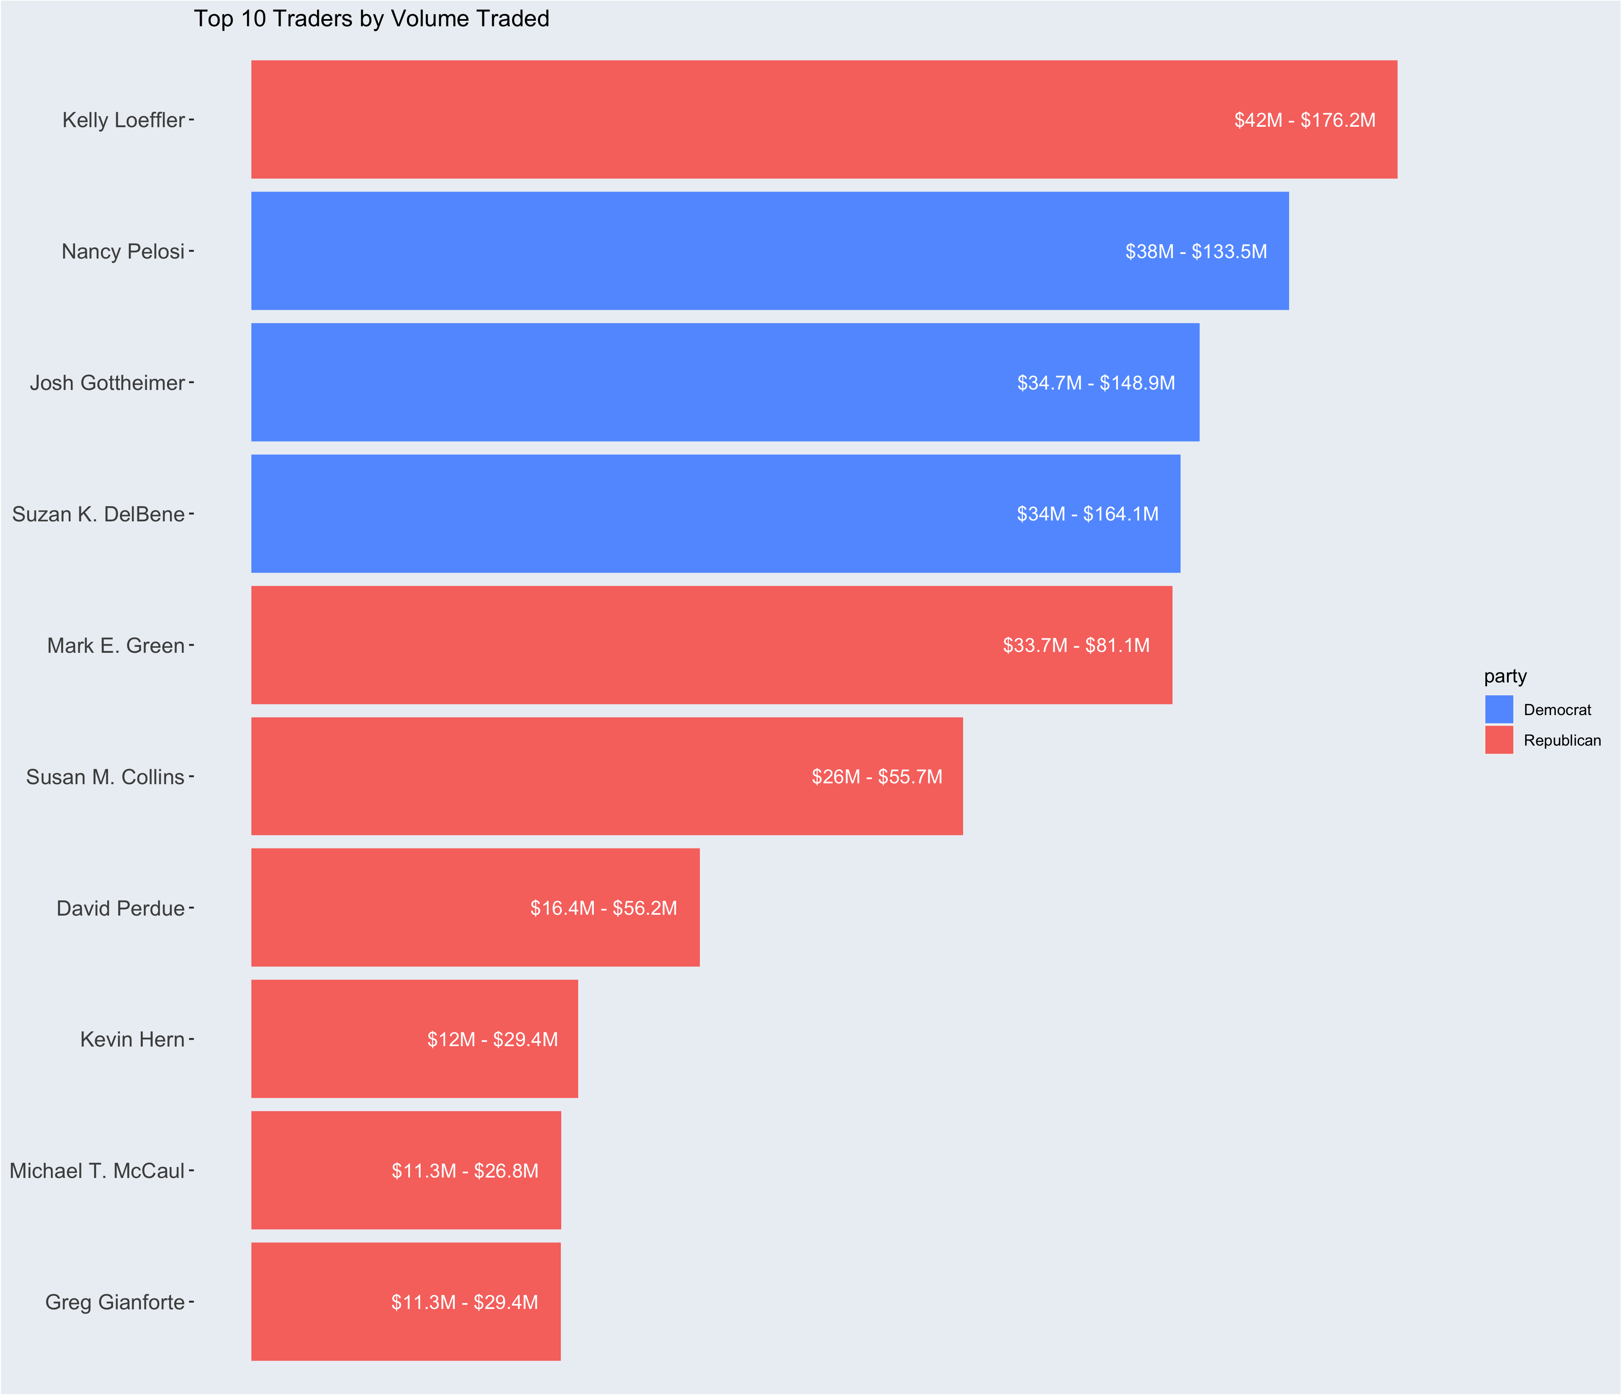
Notes:
Let’s look at the most transactions and biggest volumed traders.
This was extremely shocking to see.
There are congresspeople, who are trading in volumes of the $10’s of Millions, just over the past 9 years.
They are moving around A LOT of money.

Slide 27
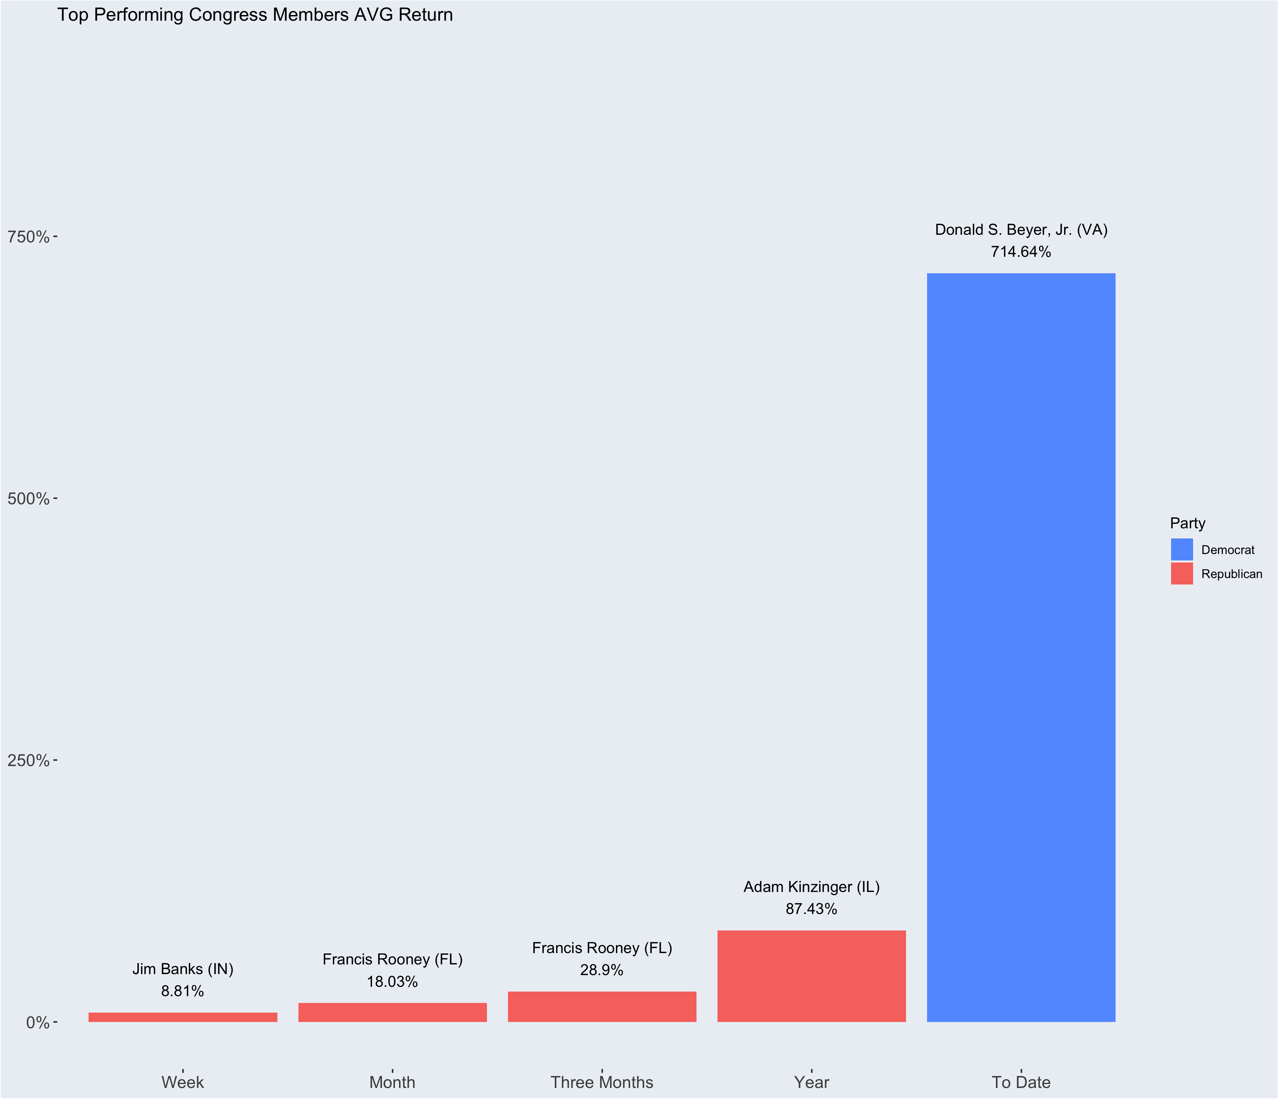

Slide 28
SINGLE OUT SOMEONE

Slide 29
WHAT’s NEXT That I didn’t have time for in this project!!!!
Live DATA
SQL Database Attached
Append the senate committees, I only got to the house ones
CONTINUE THAT SOTRYLINE ON THE DASHBOARD!!!

